Slide 1
Dallas

Slide 2
MEMBERSHIP

Slide 3
Credo
I believe the Knights of Columbus provides Catholic men in today’s world the best opportunity of following in the footsteps of Christ.
I thus want to do all within my power to grow the Order and foster healthy, vibrant councils in every parish.

Slide 4
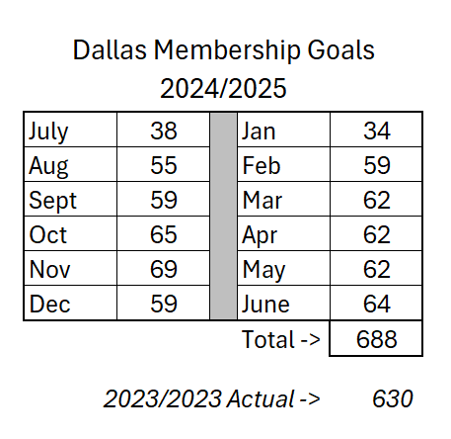
Goals

Slide 5
24/7 Membership Recruitment
John Leal
Encourage all councils to have active membership recruitment activities with drives and blitzes
Incorporate membership recruitment into all their activities.
Make programs visible and attractive
Every council and diocese with a membership director
Present ideas and motivation on specifics of recruitment
Strong, healthy, vibrant councils generally have no problems recruiting.

Slide 6
All Councils Active
Larry Pfeifer
Work specifically with Dio Ds and DDs to address councils that are at zero membership recruitment
Ascertain issues with the parish
Ascertain issues with the council
Develop strategies on a case by case basis to help the council get past issues
There should be no recruitment inactive councils in Texas.

Slide 7
Online Membership
Clint Mendonca
Promote Online Membership - as a form of membership and as a path to council membership
Scrub Online Member list to assure correct council assignment
Disseminate prospects to Dio Ds, DDs and GKs across the State
Encourage councils to work online Prospects Lists regularly
Engage Online members with regular programs
Encourage councils to

Slide 8
New Council Development & Reactivation
Beto Martinez & Manuel Gonzales (Spanish)
Maintain databases of new council and reactivation leads
Roundtables should be aimed at new councils
Work with Dio Ds and DDs to assure steps in the processes of NCD & reactivation are followed
Primary points of contact with Supreme in NCD and reactivations
Goals – 1 New Council per Diocese and 1 Reactivation per Diocese (if needed)

Slide 9
Exemplifications
JD Gutierrez
One Exemplification per District per Month
This is mandatory
Details must be entered online by the 1st
Database disseminated to Dio Ds and DDs
Build It And They Will Come

Slide 10
NexGen Membership
Josh Jones
We tell councils to recruit younger members but provide no help
Older council leaders often don't know what younger men are looking for
Promote recruitment and integration of younger members
Provide ideas and guidance on how to recruit younger members
Provide ideas and guidance on how to retain and promote yonger members

Slide 11
Membership/Council Retention/AMI
Michael Barnett
Provide membership retention support
Provide council retention support to help minimize suspended councils
Point of contact for implementation of the Affiliate Membership Initiative

Slide 12
Pastor Relations
Arlie Markusen
Works with individual councils/districts/ dioceses to help improve relationships with pastors
Helps identify shortcomings in:
Pastor's understanding of the Knights
Council's misunderstandings of how to support the pastor and parish
Provide strategies to help overcome these challenges

Slide 13
College Councils
Josh Jones
Helps ensure effective college councils
Works to ensure continuity within councils to sustain summer breaks
Helps charter new college councils and reactivate dormant college councils
Helps arrange the annual College Council Conference in the spring

Slide 14
Incentives and Methods
Regular incentives for membership growth for proposers, DDs and Dio Ds
Wives recruiting incentives
Travel Incentives over the year
New and Reactivated Council Incentives of $250 for council and $100 for Knight
Communications via regular emails
Monthly Webinars to encourage strong, healthy councils

Slide 15
Membership Committee 2024-2025
We should be encouraging all Catholic Men to follow in Christ's footsteps through the Knights
We should be working to have dynamic and active councils in all Catholic churches in Texas
Working together, we can have Texas' best year yet

Slide 16
STAR COUNCIL

Slide 26
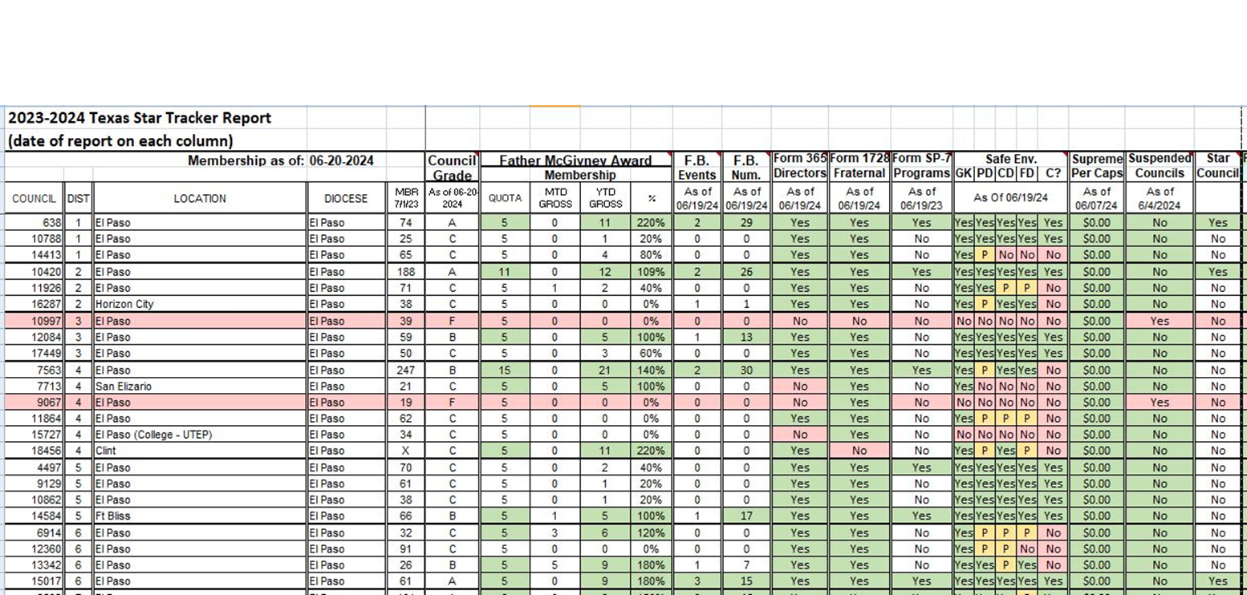

Slide 27
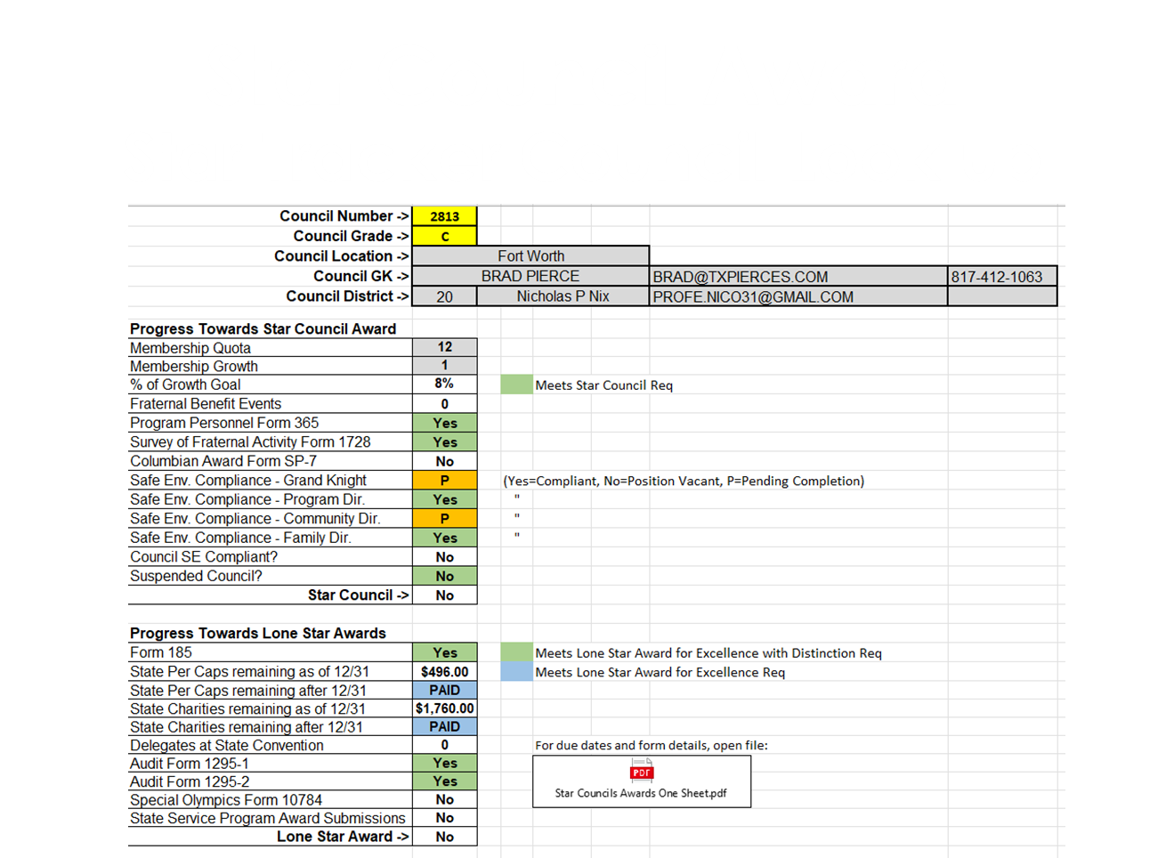

Slide 28
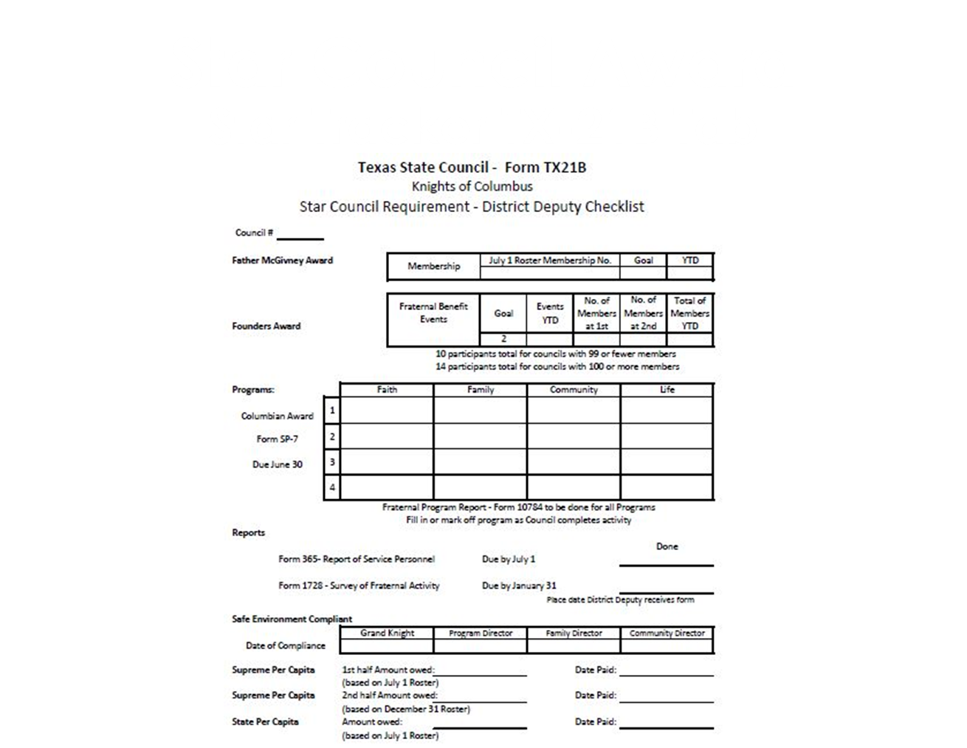

Slide 30
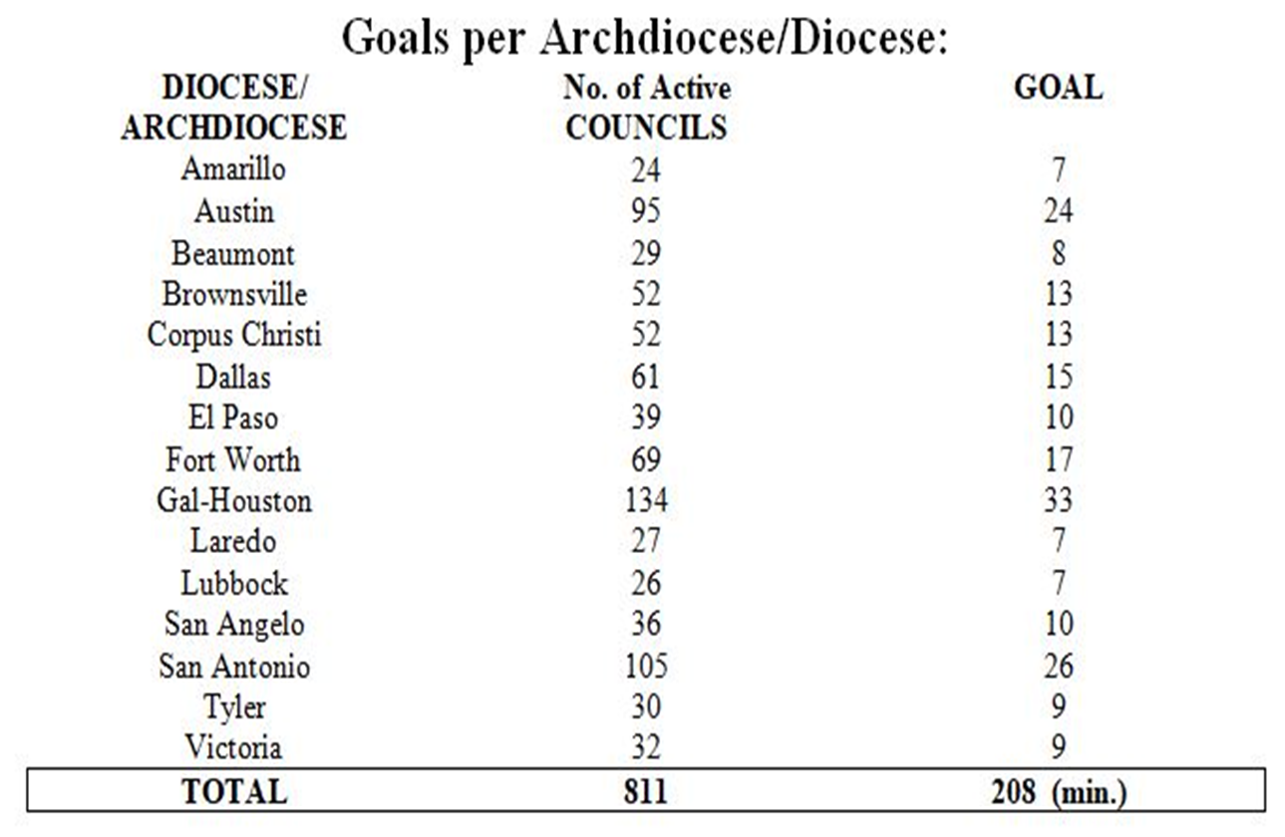
Star Council Award

Slide 32
CHARITY

Slide 33
Texas State Council Charities
A big thank you to all the Councils for their ongoing efforts to make Texas the most charitable jurisdiction in the order.
Last year was truly outstanding!
We urge all Texas councils to show support for our Texas Bishops by contributing toward your state charity goal.

Slide 34
Texas State Council Charities
Diocese of Dallas
Your 2024/2025 TSCC Diocesan goal is TBD

Slide 35
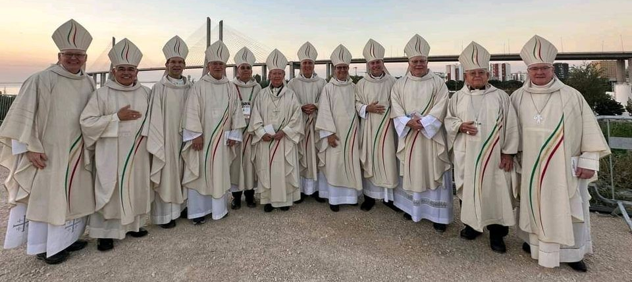
Texas State Council Charities.
How can we reach and exceed our TSC Charity Goals to give our Texas Bishops the most ever!

Slide 36
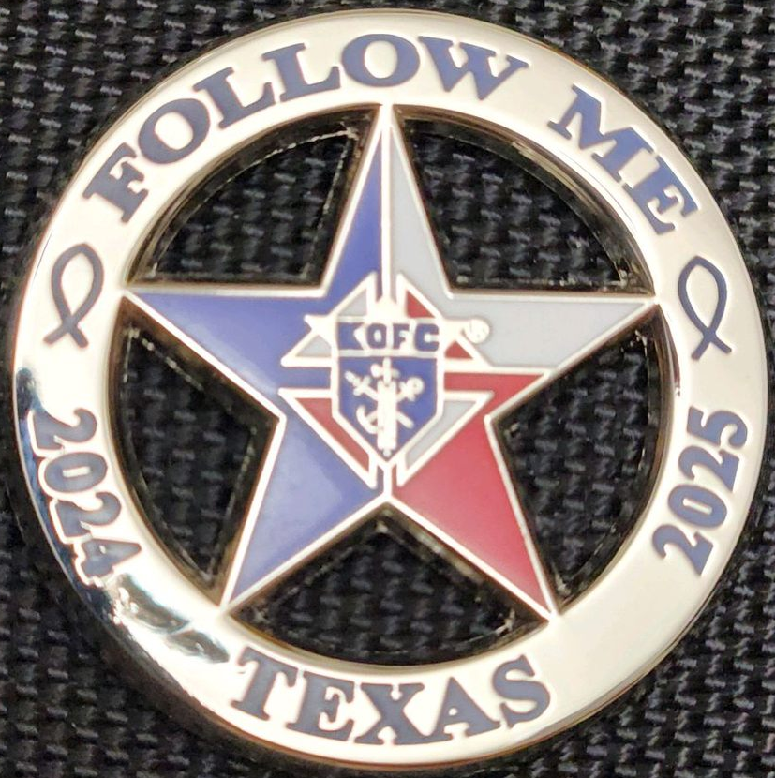
The New Texas State Charity Pin.

Slide 37
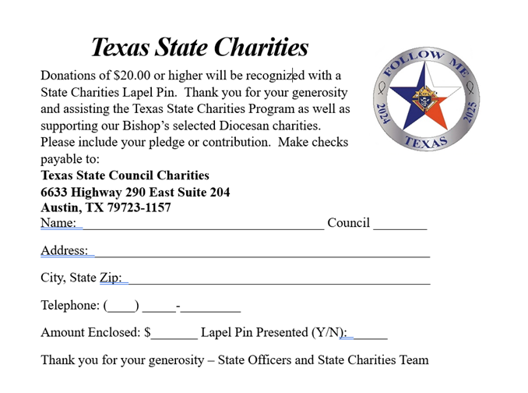
The New Texas State Charity Pin.
Pins are sold to help you surpass your goal!
The price for each pin is set at $20.
A total of 8,000 pins are manufactured annually.
This could potentially generate an extra $160,000 for our Texas Bishops.

Slide 38
HOW IS MY GOAL SET?
Your council's goal is set at a contribution of $10.00 per regular member, based on your Council membership roster as of July 1, 2024.

Slide 39
WHERE DOES MY MONEY GO?
It's important to note that 70% of your Council's charity donation will go to the Bishop’s Charity of Choice of your diocese.

Slide 40
WHERE DOES MY MONEY GO?
The remaining 30% will be managed by the State Council Charity Board for charitable causes across the state. Any funds exceeding 100% of charity target will be given back to your Bishop’s Charity.

Slide 41
Bishop Edward J. Burns – Diocese of Dallas
Persons with Disabilities and Deaf Ministries.
Where Does My 70% Go?​

Slide 42
Where Does My 30% Go?
Special Olympics
Disaster Relief
College Catholic Centers
Front Line Faith
Habitat for Humanity
Other requests that are brought to Texas State Council for consideration.

Slide 43
Charity Fundraising Team
Chairman
Josh Gomez - Ft. Worth
(972) 313-5398 JoshGomezKofC@gmail.com
Committeemen
Mario Mallari - El Paso
(915) 373-5794 mpogie10@gmail.com
Bob Schmidt - Houston/Galveston
(281) 798-0817 rhsch03@aol.com
Thomas Oaks – Brownsville
(956) 648-0463 major.oaks_1995@att.net

Slide 44
Charity Fundraising Team
Our aim is to achieve 100% or more, of the State Charity Goal for every Council and Diocese.

Slide 45
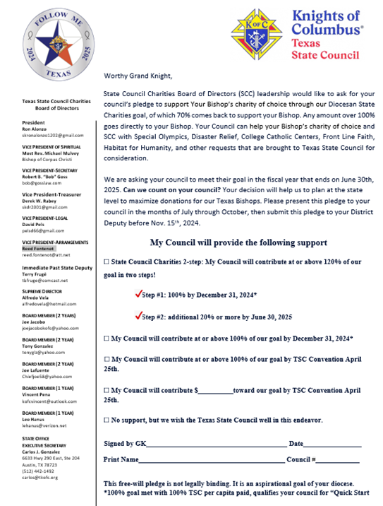
TSCC Pledge Letter
The Texas State Council State Charities Pledge letter.
The letter aims to inform and inspire your council to back your Bishop's chosen charity. Highlight the distribution breakdown between your Bishop and TSCC (70% - 30%).

Slide 46
TSCC Pledge Letter
Letters will go out to every District Deputy to distribute to every GK in the month of August.
Data will be collected by the Mid-Year Meeting, in December

Slide 47
TSCC Pledge Letter
Letters will offer various choices for your council to consider. Your council can opt for the 2-step approach, aiming to achieve 120% of the goal by the 2025 TSC Convention, or choose 100% or less. Additionally, councils can choose to be a noncontributing council. Your pledge, regardless of the amount, is valued by us without any judgment.

Slide 48
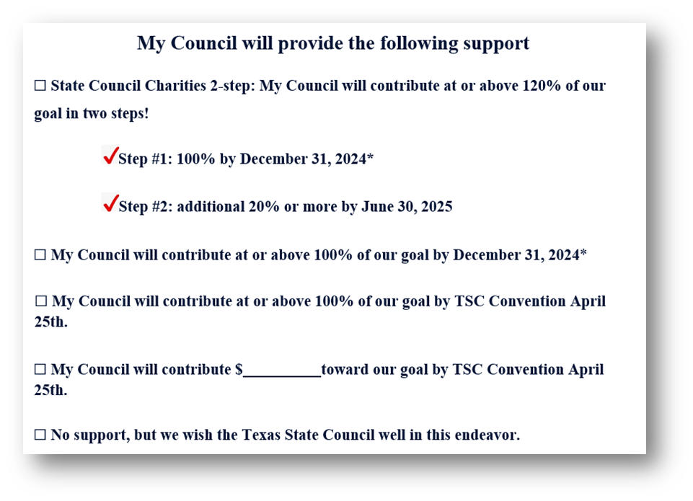
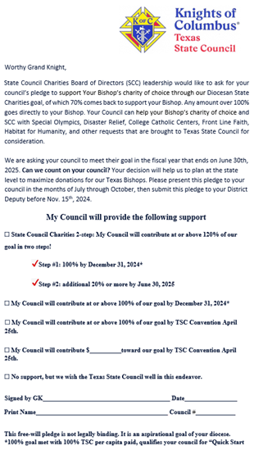
TSCC Pledge Letter
Option #1 (Preferred) TSCC 2-Step
-Step 1: 100% by 12/31/24
-Step 2: Additional 20% by 06/30/25
Option #2
100% or more by 12/31/24
Option #3
100% or more by April 2025
Option #4
Contribute a certain amount
Option #5
No support

Slide 49
Texas State Council Charity Trivia
Keep an eye out for the "Texas State Council Charity Trivia" on all social media platforms. Our goal is to update all followers on the impactful projects funded by your charitable contributions. Engage with this trivia to discover interesting facts. Put your knowledge to the test at the 2025 TSC Convention in Corpus Christi, where we will reward the most knowledgeable participants with prizes!

Slide 51
TSCC Special Areas Wheelchair Mission
^{Chairman}
^{Bill Weber}
214-405-8023 yankeesweb@tx,rr.com
Assistant Chairman
Brian Nelson
210-275-7921 abn091951@gmail.com

Slide 52
TSCC Special Areas Wheelchair Mission
Estimate 100 Million people are in need of a wheelchair.
Children and elderly are most in need.
Give the life changing gift of mobility.
1 chair improves the lives of 10 people involved in their life.
Six sizes available at the average price of $150 (valued for over $500)

Slide 53
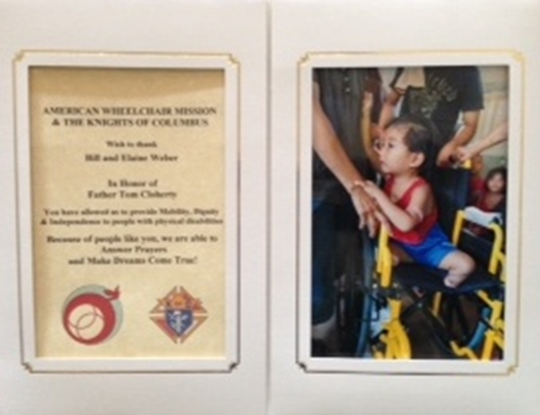
TSCC Special Areas Wheelchair Mission
For every $150 donation, a wheelchair is provided, and donors can request a personalized certificate of thanks, along with a photo of a wheelchair recipient, suitable as a gift in honor or memory of a loved one.

Slide 54
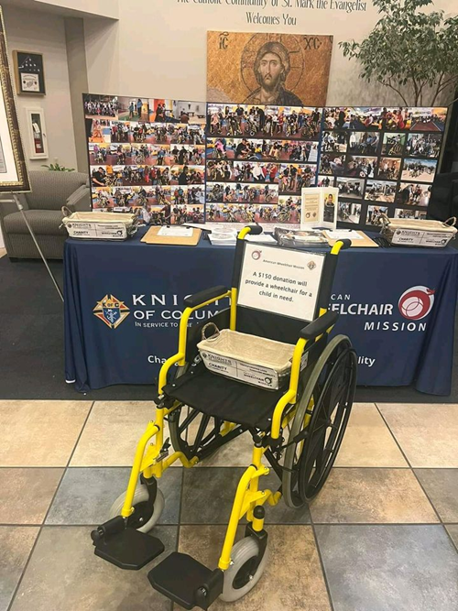
TSCC Special Areas Wheelchair Mission
We aim to enhance the frequency of Wheelchair Sundays across Texas.
Easy way raise money for those in need of mobility.
Great recruitment opportunity.

Slide 55
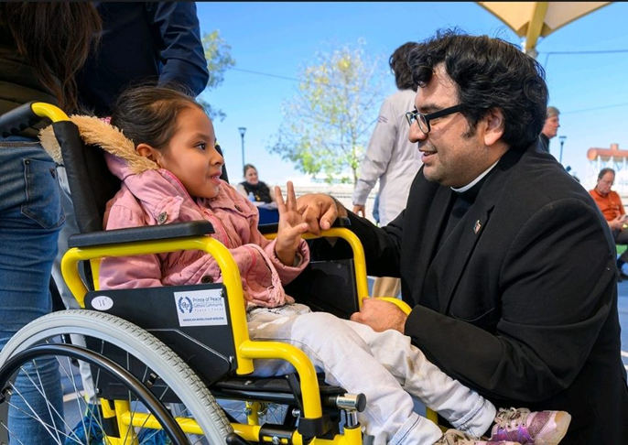
TSCC Special Areas Wheelchair Mission
Encourage councils to budget
$150 for the purchase of one wheelchair.
Thank you on behalf of the Wheelchair team and TSC. For making the last two years one of the best!

Slide 56
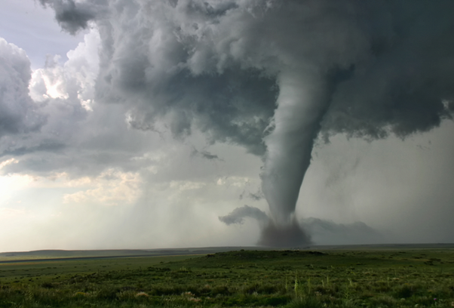
TSCC Special Areas – Emergency Response
^{Chairman} ^{Harry Storey}
214-557-2923 hss@storeycorp.net
Regional & Diocesan ERC’s
Can be found on the online Star Guide.

Slide 57
TSCC Special Areas – Emergency Response
Emergency response mission statement.
The mission of our emergency response program is to provide guidance and assistance to our brothers and councils before and after disasters.

Slide 58
TSCC Special Areas - Emergency Response
Emergency response mission
We offer guidance to councils and Knights through our statewide ERC coordinators to facilitate coordinated emergency response efforts.

Slide 59
TSCC Special Areas Emergency Response
Emergency response mission
Our relief assistance comes through charitable giving from our brothers and councils.

Slide 60
TSCC Special Areas – Emergency Response
Emergency Preparedness
Know your Diocesan ERC.
Encourage councils to appoint local ERC
Encourage councils to budget a $500 Emergency Response fund.
Is your home and family prepared?

Slide 61
TSCC Special Areas Emergency Response
TSCC Disaster Fund
100% of all funds go to assist those in need.
Policy and procedures are in place to equally distribute funds.
All distributions are carefully documented and evaluated.

Slide 62
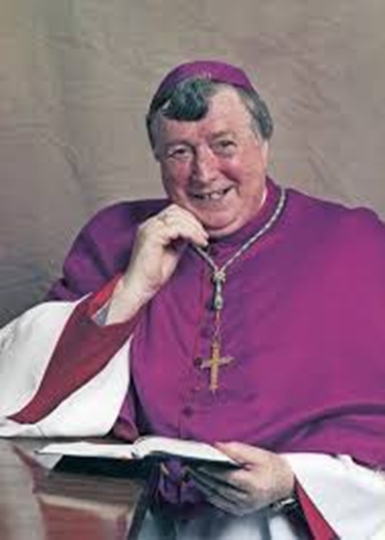
TSCC Special Areas
Bishop Thomas J. Flanagan Fund
^{Chairman}
^{Dan Stoffel}
⁴⁶⁹⁻⁶⁸²⁻¹⁰⁴⁶
^{danstoffel@yahoo.com}

Slide 63
TSCC Special Areas
Bishop Thomas J. Flanagan Fund
The fund is named after Bishop Thomas J. Flanagan, who served as Auxiliary Bishop in the Archdiocese of San Antonio from 1998 to 2005 and as State Chaplain for Texas State Council from 2000 to 2002.

Slide 64
TSCC Special Areas
Bishop Thomas J. Flanagan Fund
This fund Benefits the care of retired priests.
Acquiring and displaying a Texas Knight of Columbus license plate on your vehicle.
Benefits You!

Slide 65
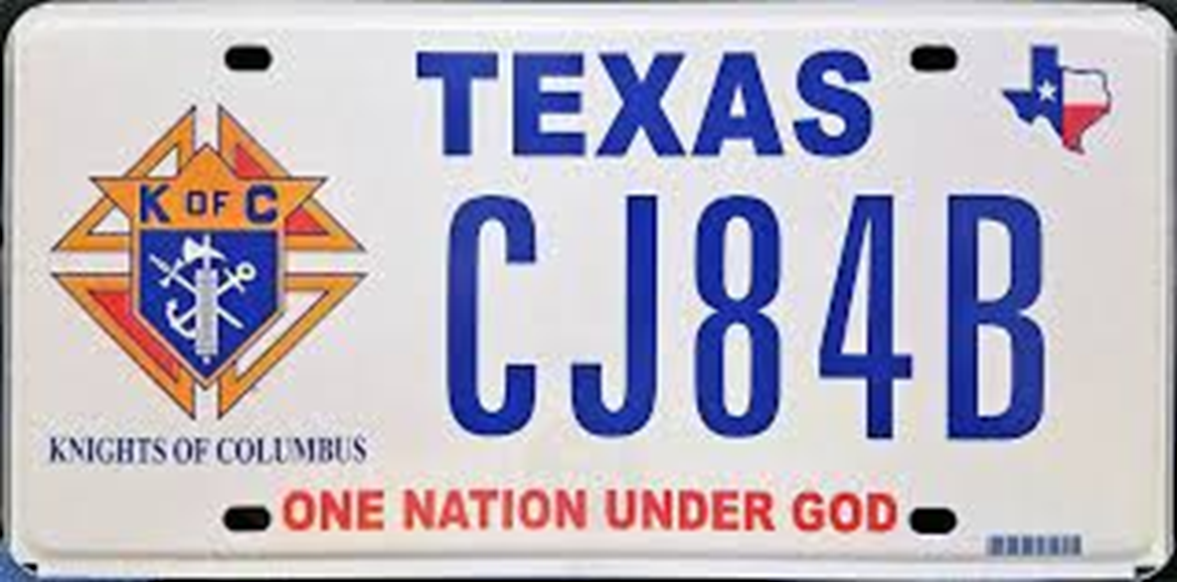
TSCC Special Areas
Bishop Thomas J. Flanagan Fund

Slide 66
TSCC Special Areas
Bishop Thomas J. Flanagan Fund
By purchasing or renewing a K of C license plate, you can support Infirmed Priests. The plate costs an extra $30 annually, with $22 returned to TSCC.

Slide 67
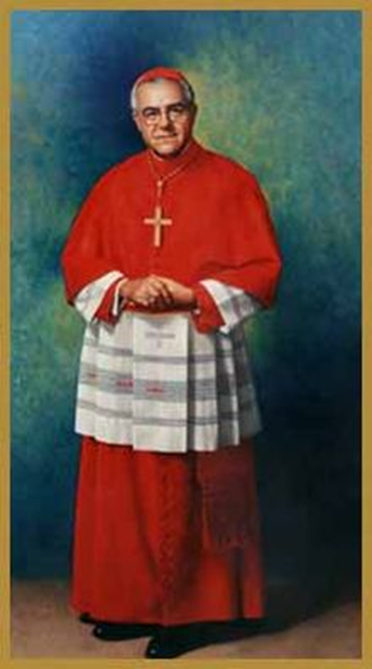
TSCC Special Areas Cardinal Medeiros Trust & Educational Grants
^{Chairman}
^{Leo Saenz}
512-831-8516 leosaenz@gmail.com
Assistant Chairman
Ken Orze
678-656-3911 k.orze@yahoo.com

Slide 68
TSCC Special Areas Cardinal Medeiros Trust & Educational Grants
The Cardinal Medeiros trust fund was set up in 1981 and became part of the Texas Council Charities program. Cardinal Humberto Medeiros was previously the Bishop of Brownsville and served as Texas State Council chaplain. He later became the Archbishop of Boston in 1970 and was elevated to cardinal in 1973.

Slide 69
TSCC Special Areas Cardinal Medeiros Trust & Educational Grants
The Cardinal Medeiros fellowship program was started to increase the principal in the Education trust fund. This fund benefits Texas Catholic Schools & College Students.

Slide 70
TSCC Special Areas Cardinal Medeiros Trust & Educational Grants
To become a Cardinal Medeiros fellow, a $1,000 contribution to TSCC is required. The honoree receives a plaque, lapel pin, and their name engraved on the honor roll displayed at the Texas State council office and convention annually.

Slide 71
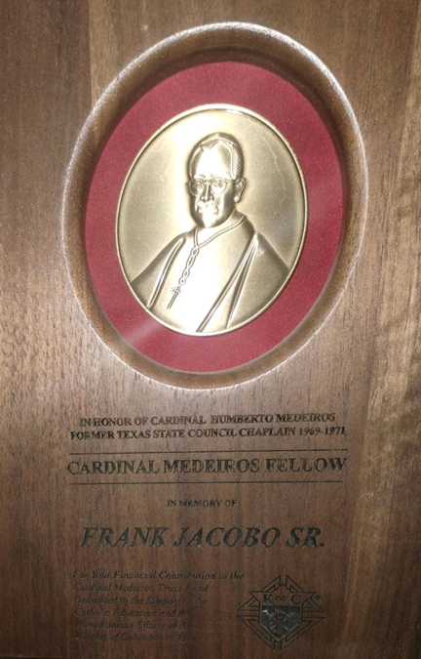
TSCC Special Areas Cardinal Medeiros Trust & Educational Grants
There are an approx. 367 Fellows.

Slide 72
TSCC Special Areas - Special Olympics
^{Chairman}
^{Chris Hoefer}
903-736-5309 choe6482@aol.com

Slide 73
TSCC Special Areas Special Olympics Mission Statement
Special Olympics Texas offers year-round sports training and competitions in Olympic sports for individuals with intellectual disabilities. The mission aims to promote physical fitness, courage, joy, and social interaction among participants, their families, and the community.

Slide 74
Partership with Special Olympics (Form #10784)
Councils must fill out Form #10784 to report involvement with Special Olympics, detailing events, contributions, and hours. State Council Charity participants can report 2.5% of donations. Reports are due January 31 each year regardless of involvement.
Reporting is crucial for Texas athletes to potentially receive up to $9,000 from Supreme!

Slide 75
Special Olympics Chic O'Conner Award
Chic, a dedicated Knight, played a key role in establishing Special Olympics in Gregg County. The Charles 'Chic' O'Conner Annual Memorial Award was created in his honor to commend a Brother Knight's outstanding support of Special Olympics Texas, focusing on leadership, volunteering, fundraising, and community engagement. Submissions for the award are due by January 31 each year.
One winner named by TSC is recognized at the State Convention. .

Slide 76
PROGRAMS

Slide 77
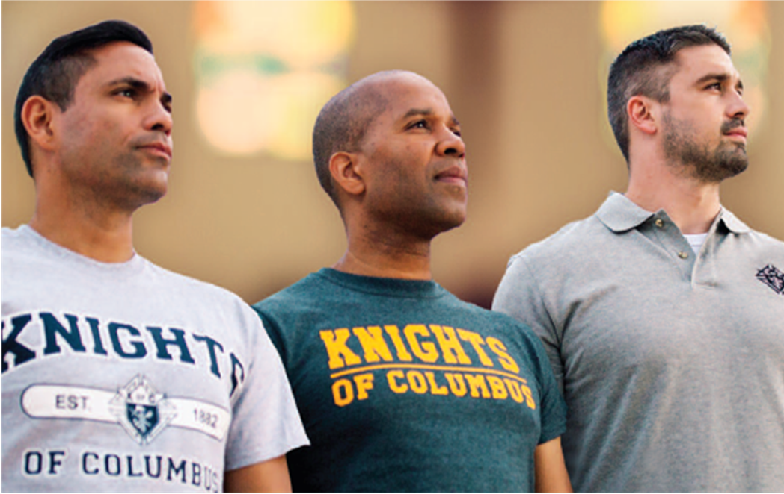
PROGRAMS
Program Director
Rick Guzman
Fraternal Year
2024-2025
skrickguzman6021@gmail.com
210-215-7196
Faith In Action

Slide 78
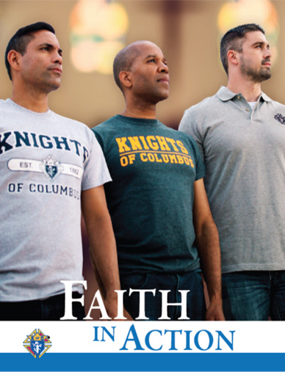
Your Guidebook
Faith in Action Manual
•This provides a full explanation about each of the 4 categories (Faith, Family, Life, Community) and the 32 programs
•Important information about starting programs, meeting with the pastor, keeping members motivated
•Safe Environment requirements
•Star Council Awards, Columbian Award, Fr. McGivney Award, State Council Service Awards
•And the Supreme Chaplain's Faith in Action Monthly Challenge
Everyone who gets a planner should get this manual

Slide 79
Faith in Action Resources
#10907 Faith in Action Guidebook
#10746 Faith in Action Minimum Requirements
#10581 Faith in Action FAQs
#11172 Faith in Action Program Forms Reference Guide - NEW
#11139 Faith in Action Remote Programming Supplement
#1842 & 1842S Member Experience Interest Survey

Slide 80
RECOMMENDED PROGRAMS
Faith Community
RSVP Global Wheelchair Mission
Into the Breach Habitat for Humanity
Spiritual Reflection Helping Hands
Holy Hour Coats for Kids
Pilgrim Icon Program Disaster Preparedness
Building the Domestic Church Free Throw Championship
Rosary Program Catholic Citizenship Essay Contest
Sacramental Gifts Soccer/Hockey Challenge
Helping Hands & Cornhole Championship

Slide 81
RECOMMENDED PROGRAMS - continued
Family Life
Food for Families March of Life
Family of the Month/Year Special Olympics
Family Fully Alive Ultrasound Program
Family Prayer Night Pregnancy Center Support
Keep Christ In Christmas Christian Refuge Relief
Family Week Silver Rose
Consecration of the Holy Family Mass for People with Special Needs
Good Friday Family Promotion Novena for Life

Slide 82
FEATURED PROGRAMS
Minimum Requirements
When your council conducts a featured program and satisfies the associated requirements it will receive two credits towards that program category on the Columbian Award Application (SP-7), Due June 30th.
Report all completed programs on the Annual Survey of Fraternal Activity (#1728) OR Refund Form. For additional Featured Program information, review the individual program guide sheets found at www.kofc.org/fiaresources All program forms may be found at kofc.org/fiaforms

Slide 83
FEATURED PROGRAMS
Faith RSVP Into The Breach Holy Hour Spiritual Reflection
Community Global Wheelchair Mission Habitat For Humanity Helping Hands Coats For Kids
Family Food For Families Family of the Month/Year Family Fully Alive Family Prayer Night
Life March For Life Special Olympics Ultrasound Program Pregnancy Center Support

Slide 84
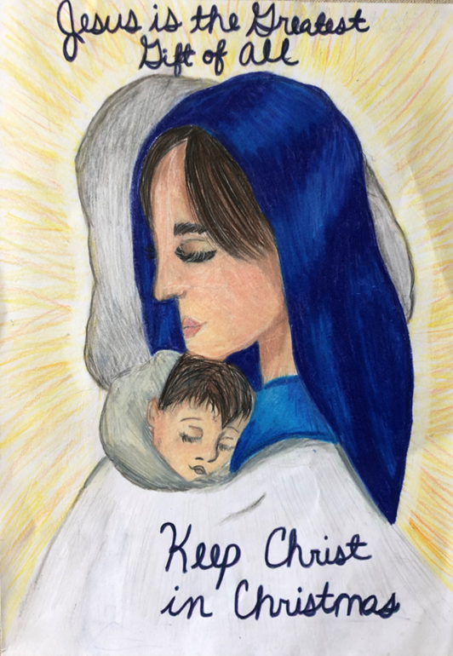
Time Sensitive Programs
Keep Christ in Christmas
•September - Order KCIC Kits
•November / December - Judging done at each Council / District / Diocese level
•Jan 15, 2025 - Diocesan winners sent to State

Slide 85
Time Sensitive Programs
Catholic Citizenship Essay
•July/August - Order Kits - Confirm Current Topic
•September/ October - Students write essay
•November /December - Judging of essays at Councils, District, and Diocesan Levels
•Jan 15, 2025 - Diocesan winners sent to the State.
Soccer Challenge
•August / Sept - Council Level
•September / October - District & Diocesan Levels
•State Level - TBD October & November

Slide 86
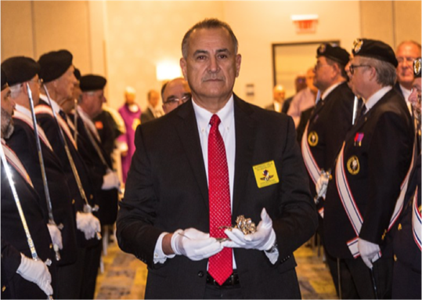
State Programs
Silver Rose
The schedule is posted in the Star Guide on Line.
Order additional Silver Rose booklets
Must submit a 10784 from after each activity for the Silver Rose.
Pilgrim Icon Prayer Program
•The current Icon is St. Joseph
•The Icons will be sent to Texas following the Supreme Convention. Must submit a 10784 from after each activity for the Icon program.
Silver Rose / Pilgrim Icon Prayer Program
Chairman - Edvardo Garcia: 210-865-5370
edvardogarcia@gmail.com

Slide 87
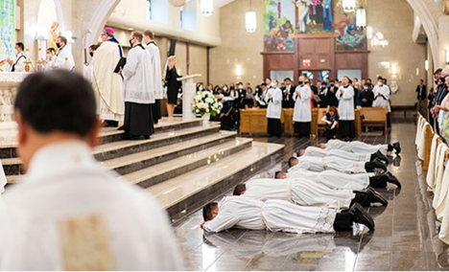
State Programs
Shield a Badge with a Prayer
RSVP / Seminary Support
Chairman Dan Stoffel will be tracking the status of our support for our seminarians.
469-682-1046 danstoffel@yahoo.com
Pray for your local officer for his/her Safety, Good Judgement, and Safe Return Home.
Pat Henz can help you get this started.
817-501-5197 pghenz@yahoo.com

Slide 88
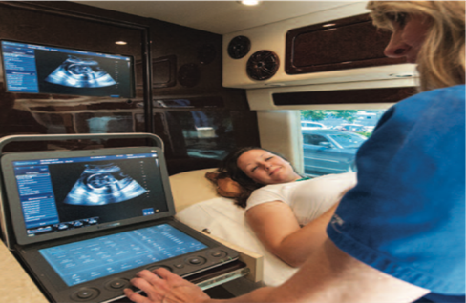
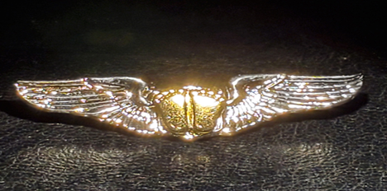
State Programs
Pregnancy Resource
Chairman Andrew Clark can assist in completing all the necessary paperwork needed by Supreme for purchasing Ultrasound machines and pre-qualifying pregnancy resource centers.
972-814-8975 situs6012@gmail.com
Pro-Life / ACE Wings
Chairman Tom Clark is the contact person for requirements and in ordering your wings, and all Pro-Life related events.
214-282-6297 tjclark123@gmail.com

Slide 89
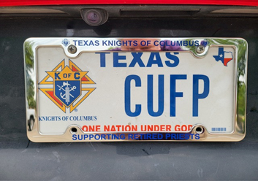
State Programs
Bishop Thomas J. Flanagan Fund - Grants for Retired Priests
This fund was newly established in 2020 and the fund is named in honor of the late Bishop Thomas J. Flanagan who served the Archdiocese of San Antonio as Auxiliary Bishop from 1998-2005 and the Texas State Council as State Chaplain from 2000-2002.
This fund was established to provide for the care and welfare of those who so faithfully served us and affords grants for our retired priests.
The primary way to contribute to this fund is by acquiring and displaying a Texas Knights of Columbus license plate on your vehicle.
Scavenger
Hunt
Chairman
Dan Stoffel
469-682-1046
danstoffel@yahoo.com

Slide 90
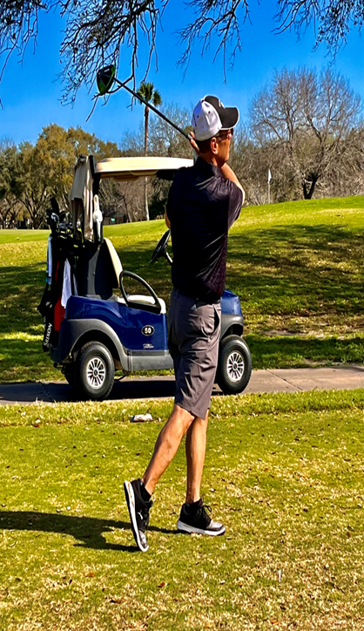
State Programs Athletics
50th Annual "Johnny Lopez"
State Golf Tournament
Chairman- Ricky Meyer
September 13th – 15th, 2024
Victoria Texas
979-732-7301
ricky.meyer33@sbcglobal
State Free Throw
Chairman - Jesse Aguilar
State Free Throw will be in San Antonio the first weekend in March, 2025, 2025
210-464-5601 jesseaguilar034@gmail.com
1st Annual State Cornhole Tournament
Chairman - James Halfmann
February 22, 2025.
Hallettsville Texas
325-234-9928
jameshalfmann@hotmail.com
State Bowling Tournament
Chairman - Mike Cook
April 2025 - Location TBD
832-298-8286
cookacad@aol.com

Slide 91
Key Things to Remember
•The success of any council comes from the success of its programs. Successful Programs attract New Members.
Without these two a council begins to fail.
If we don't perform programs, which our members are interested in, then they will find other avenues and we will lose them.

Slide 92
Key Things to Remember-continued
•District Deputies, you are the most pivotal Leader for the Grand Knights and their councils.
•Encourage your council officers and members to be active.
•Make sure everyone understands their roles and their responsibilities.
•Lead by example, get your hands dirty.
•Be the Leader that God wants you to be.

Slide 93
EDUCATION, TRAINING & COMMUNICATIONS

Slide 94
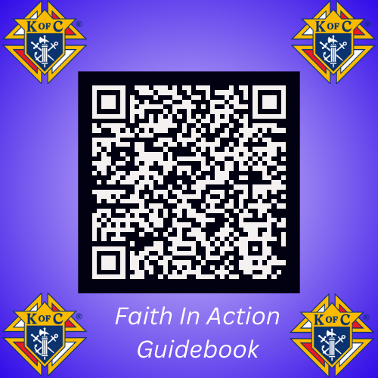
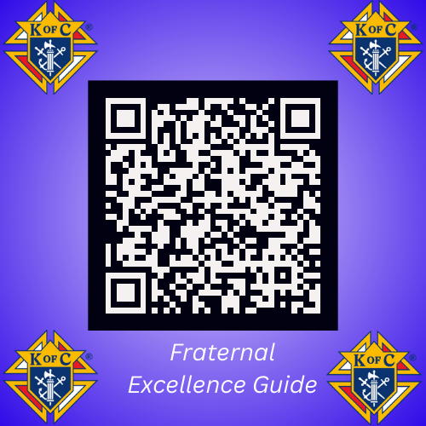
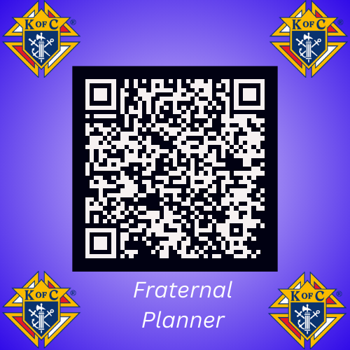
EDUCATION, TRAINING & COMMUNICATIONS

Slide 95
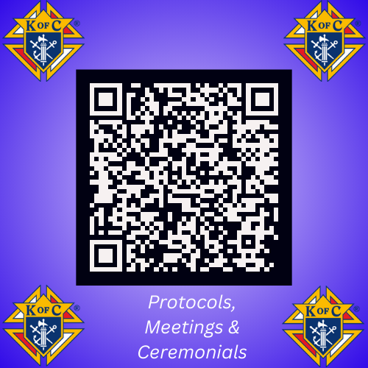
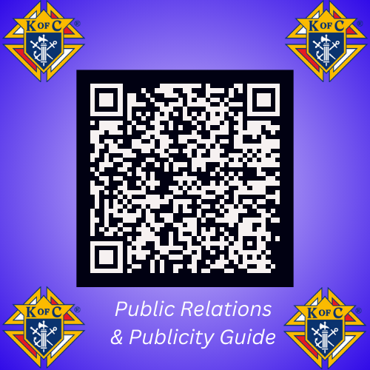
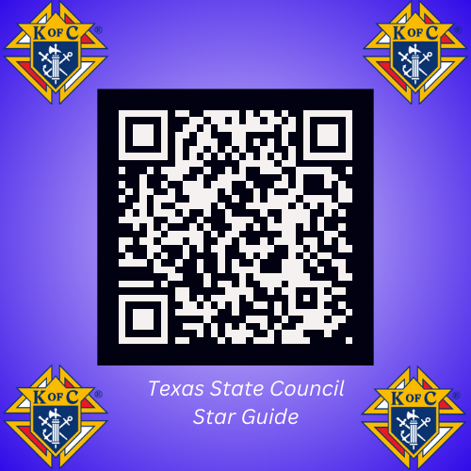
EDUCATION, TRAINING & COMMUNICATIONS

Slide 96
EDUCATION, TRAINING & COMMUNICATIONS
Meet The State Team

Slide 97
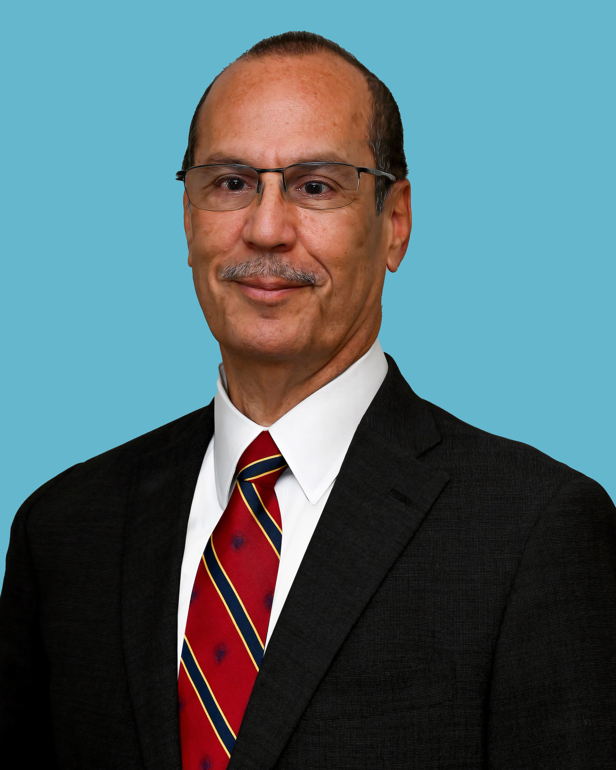
Ron Alonzo
State Deputy

Slide 98
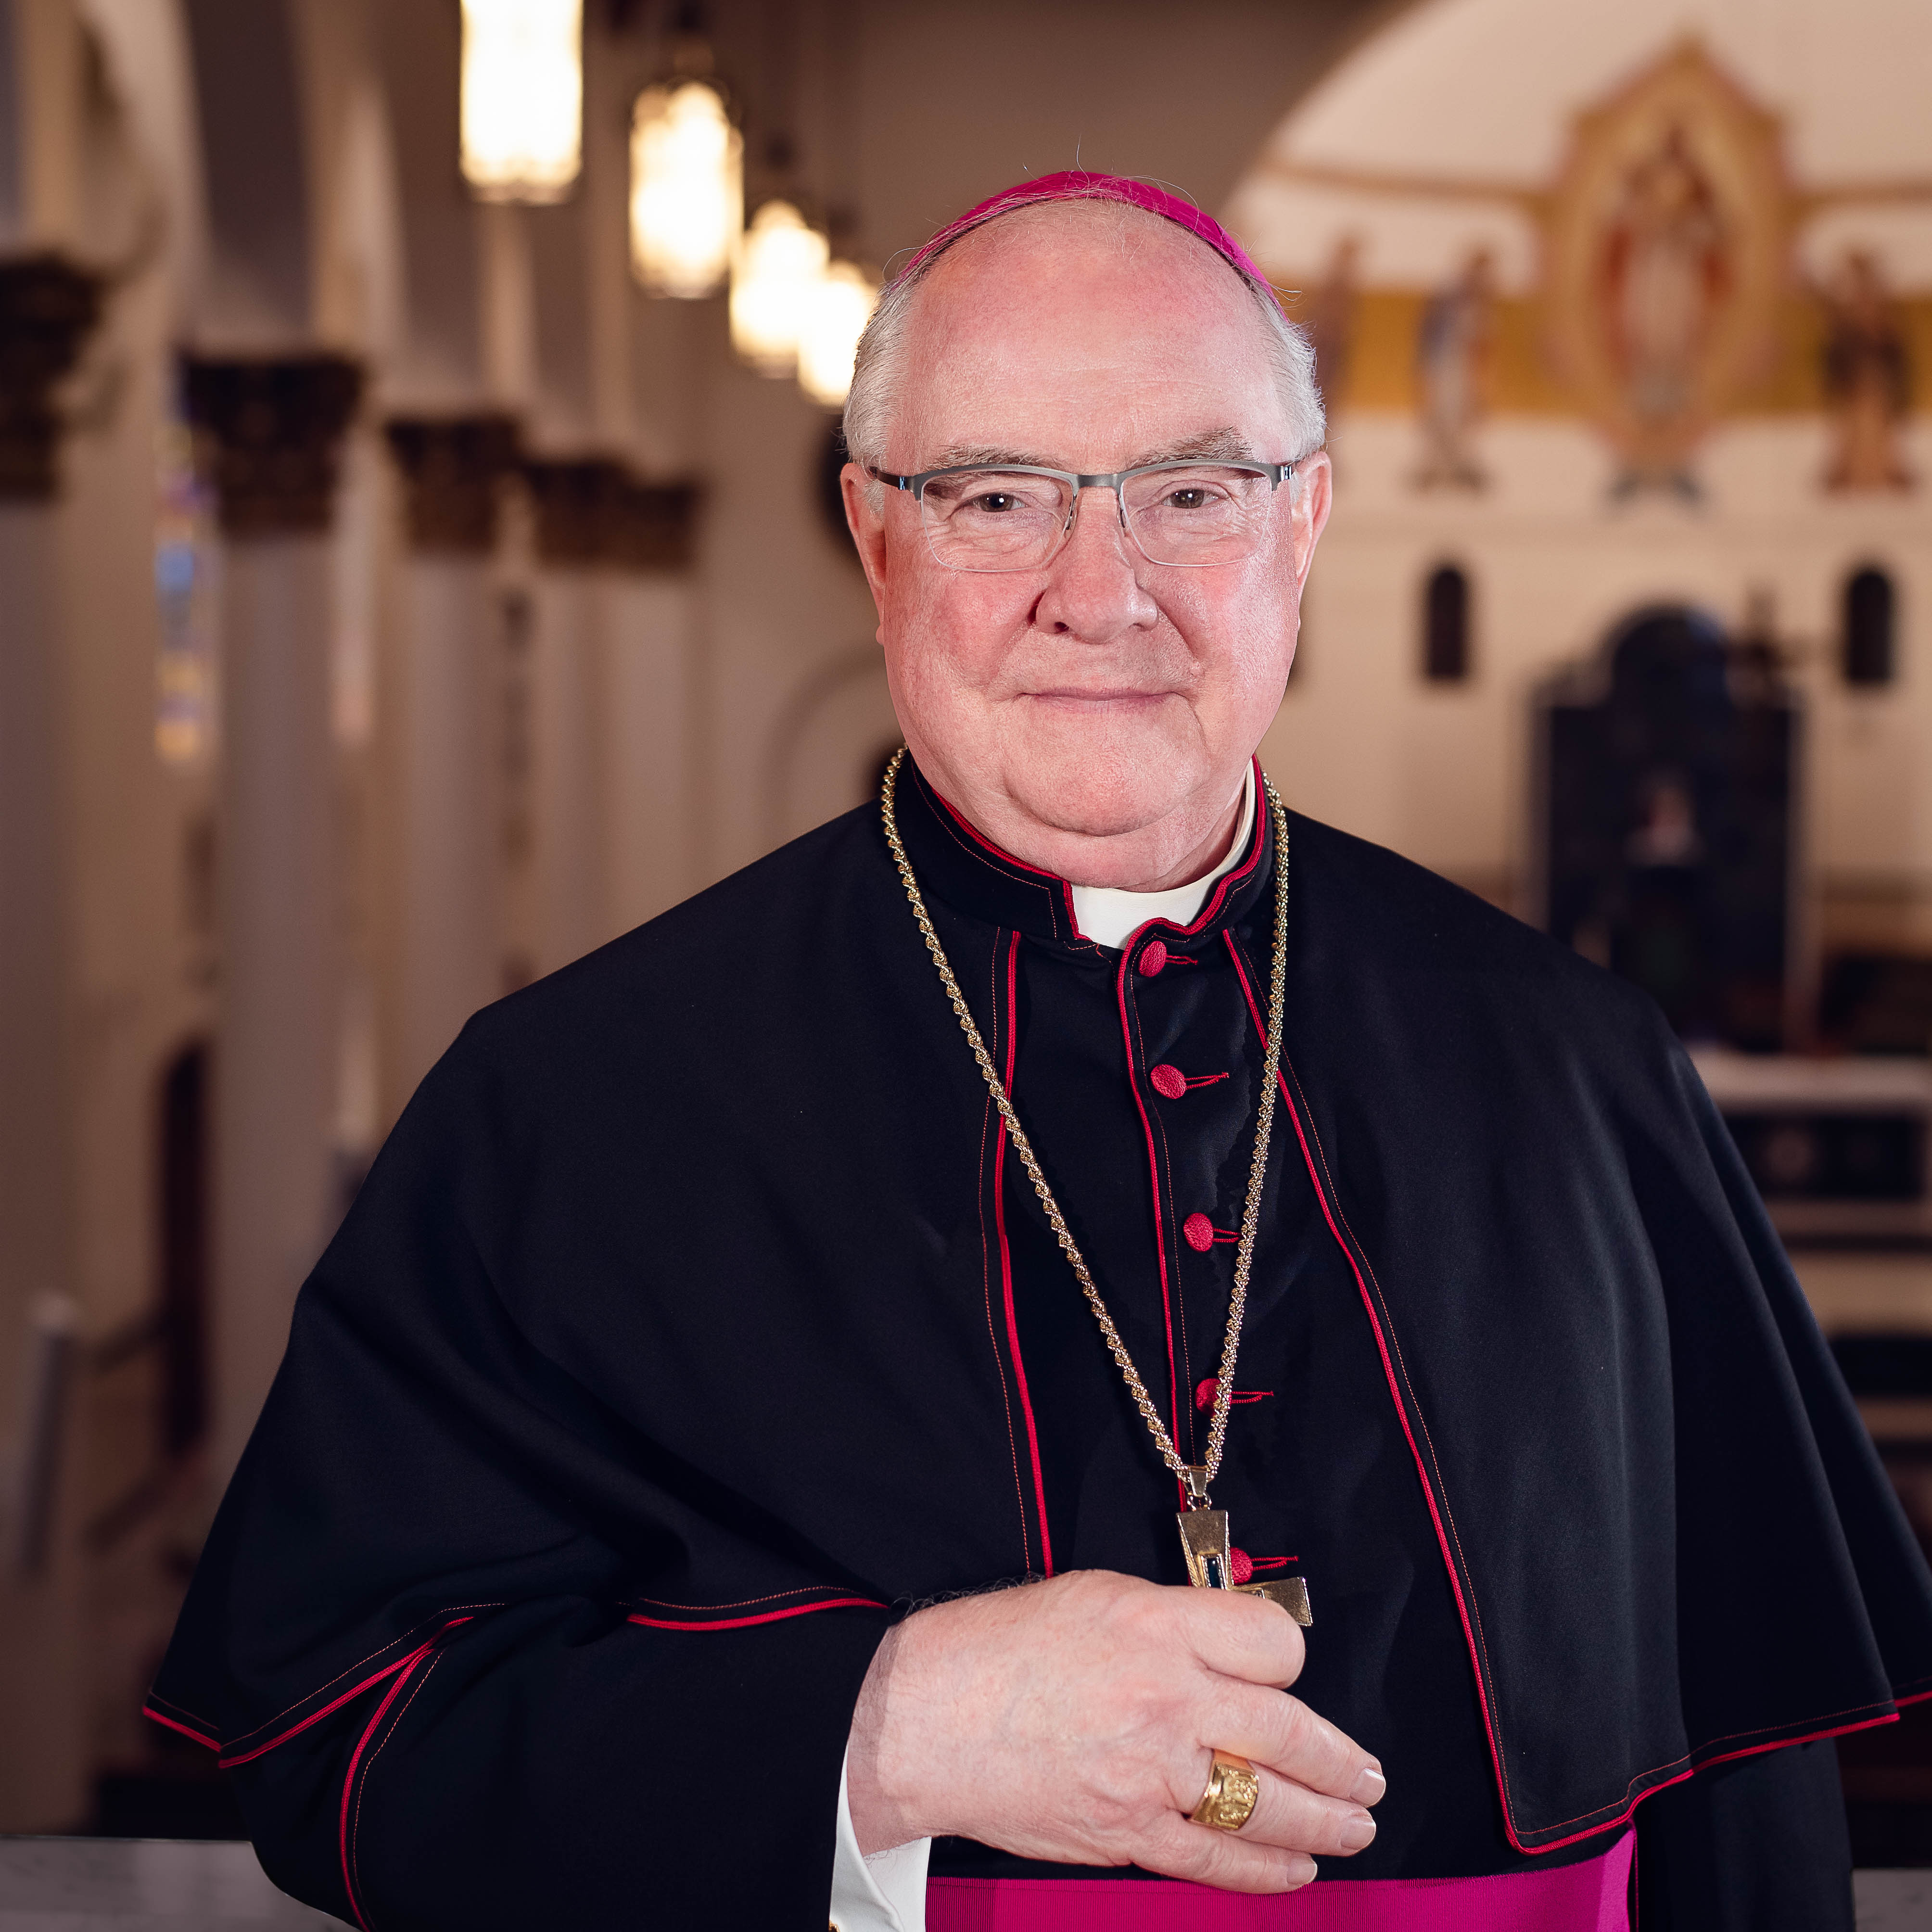
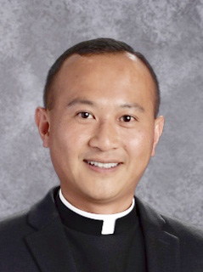
Most Rev. Michael Mulvey
Rev. Tommy Chen
State Chaplain
Assoc. State Chaplain

Slide 99
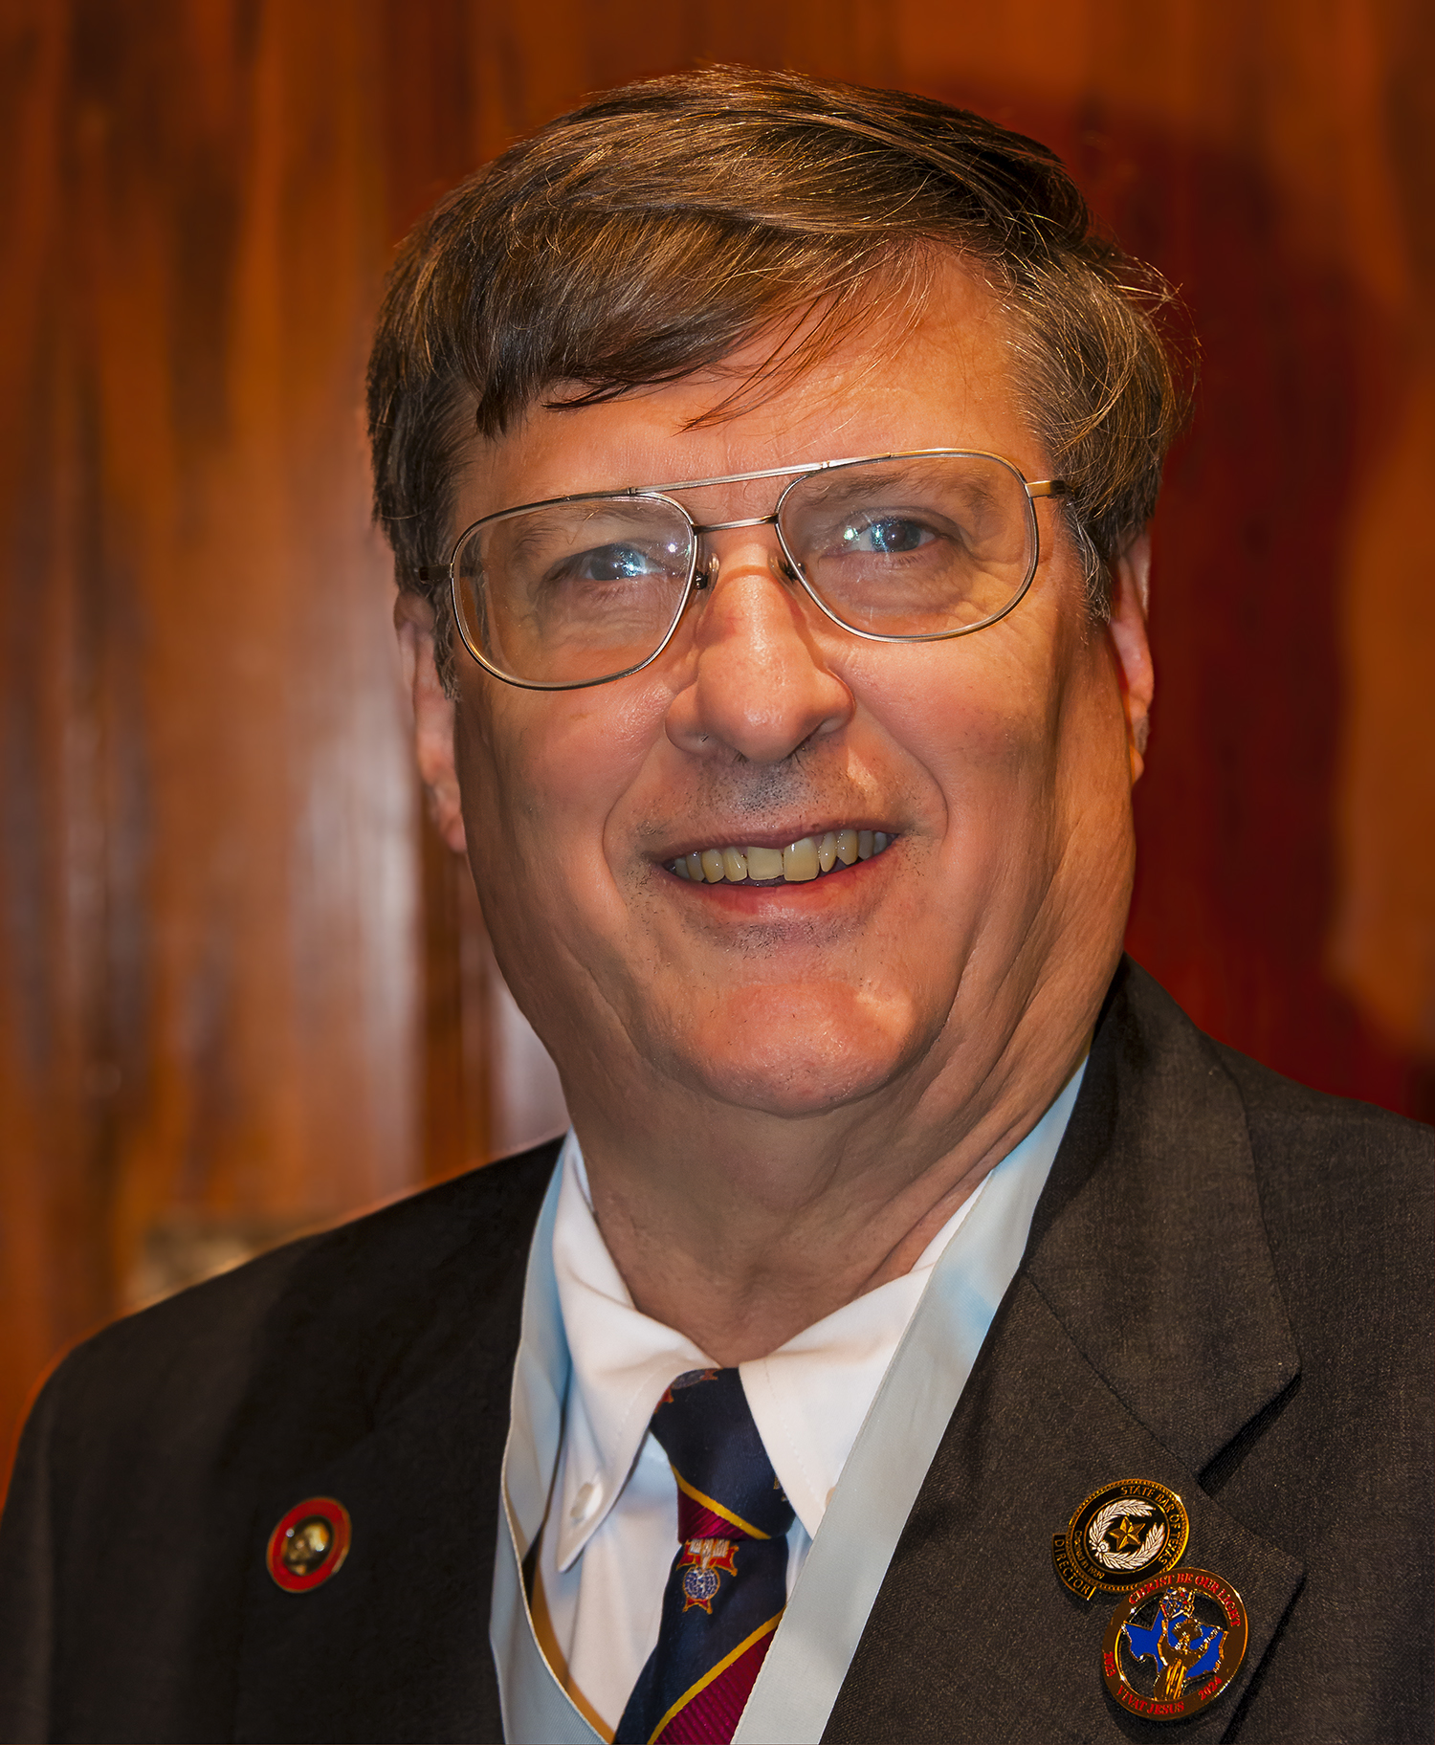
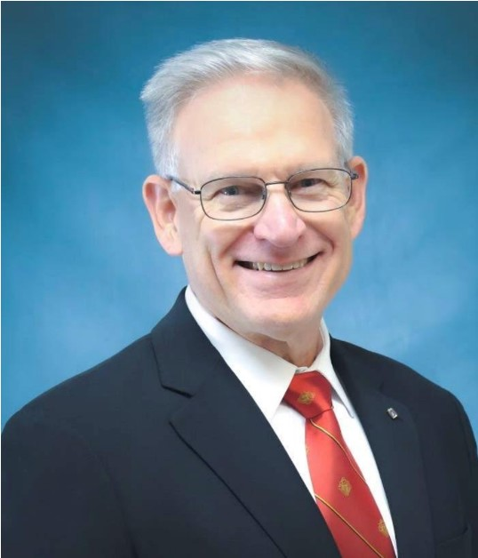
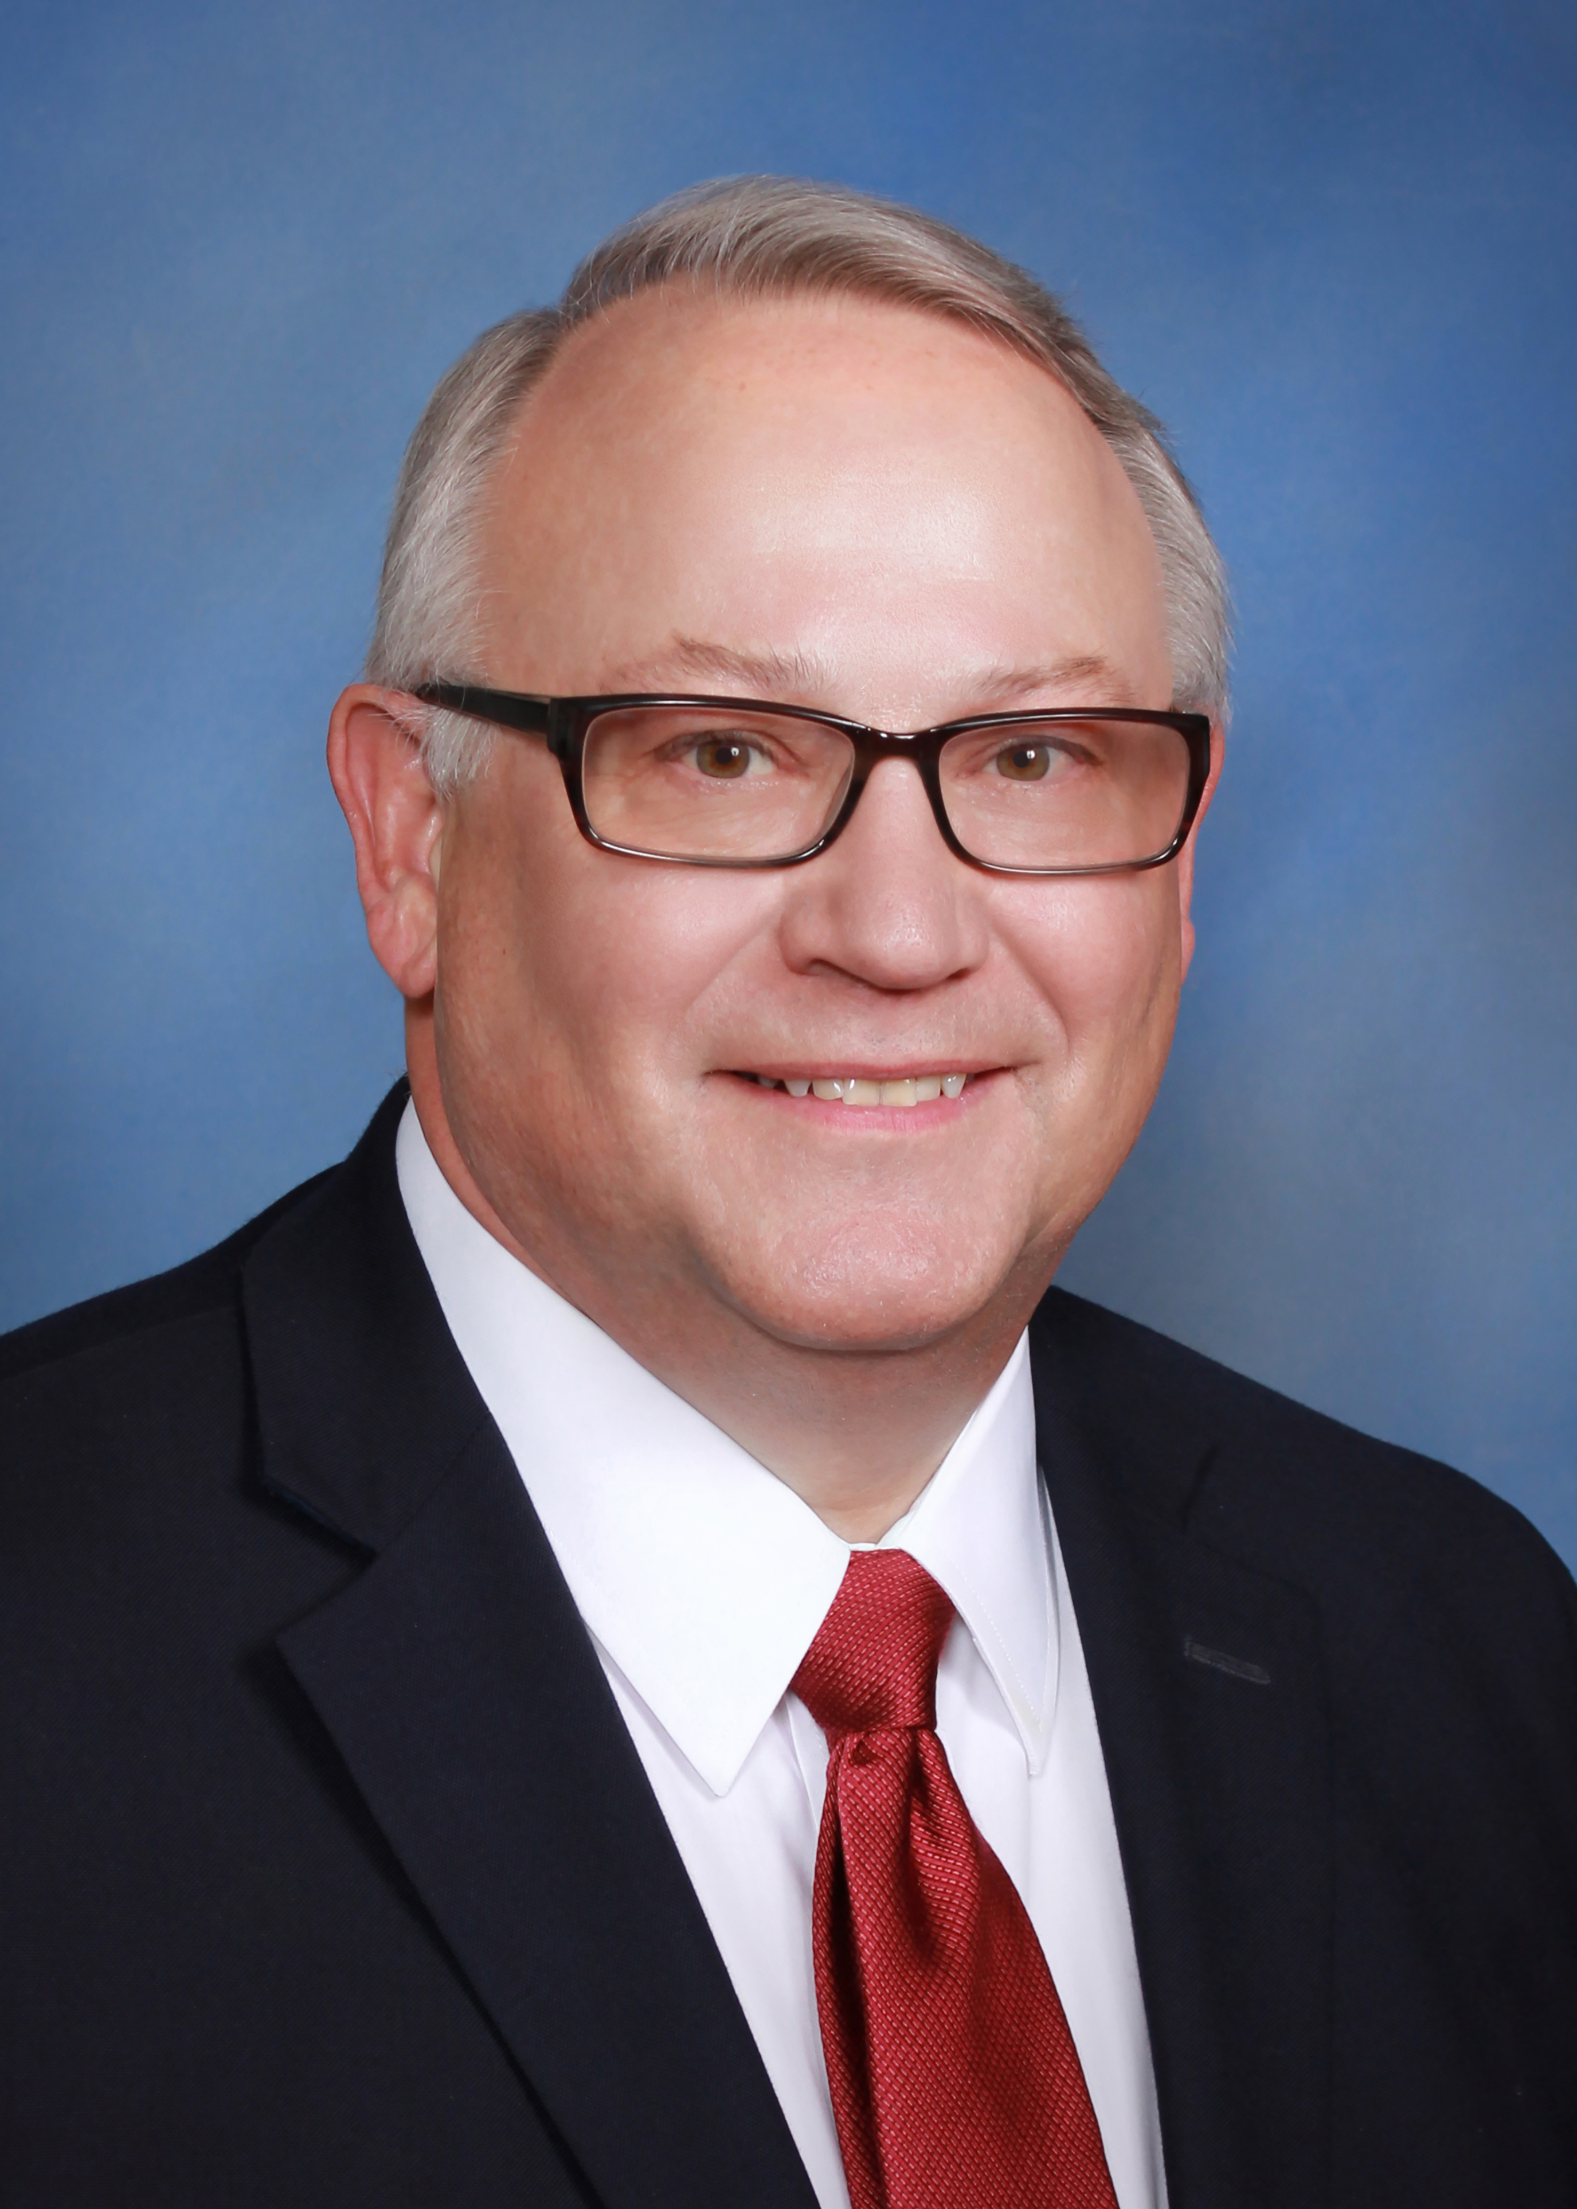
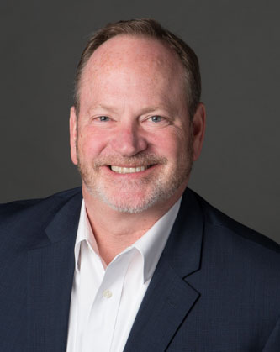
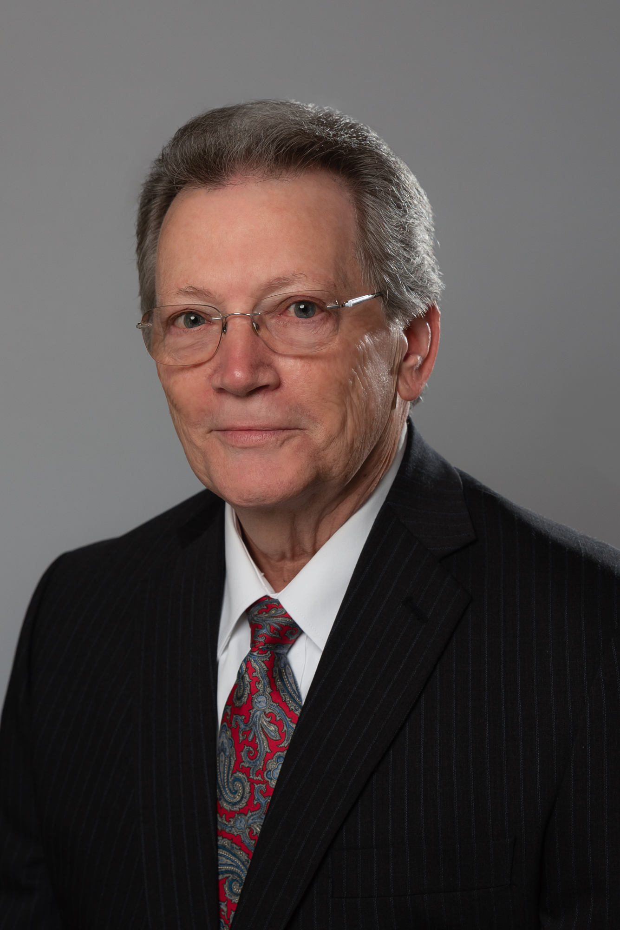
Bob Goss
Derek Rabey
David Pells
Reed Fontenot
Terry Fruge
State Secretary
State Treasurer
State Advocate
State Warden
Immediate Past State Deputy
State Officers

Slide 100
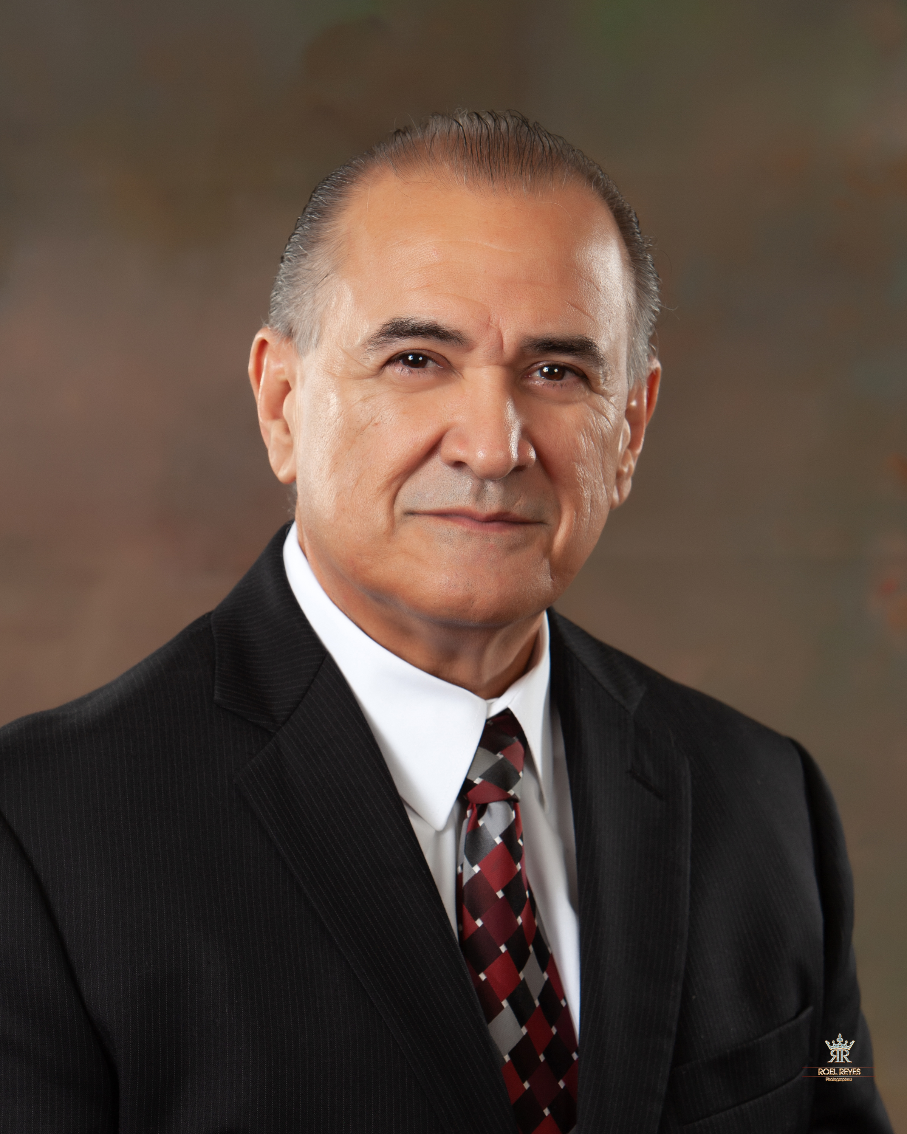
Alfredo Vela
Supreme Director

Slide 101
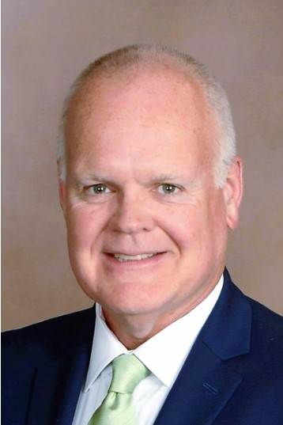
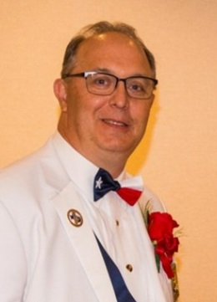
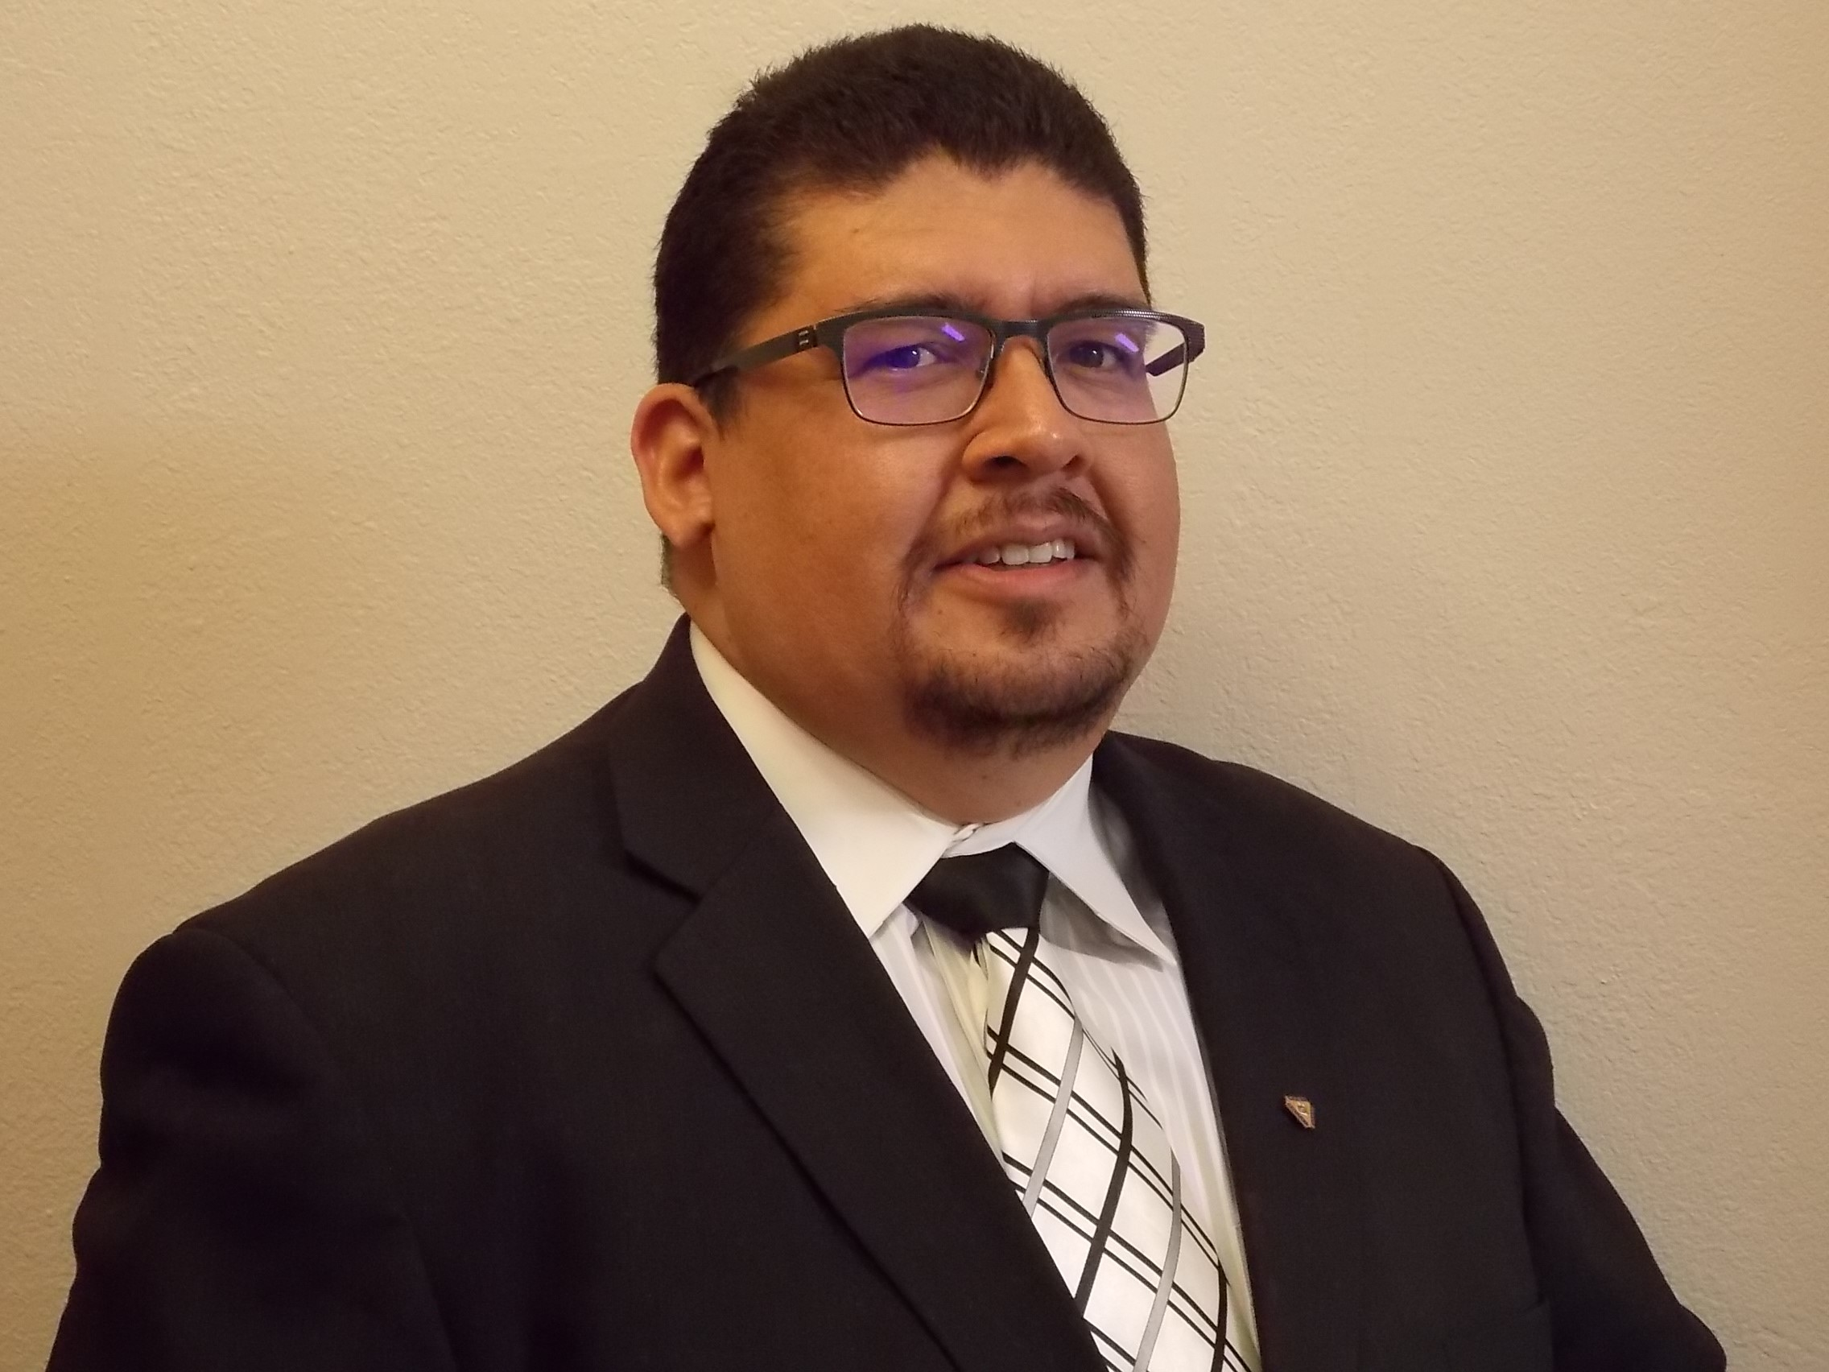
Bill Tillotson
David Zeigler
Joe Jacobo
Membership Director
Star Council Director
Charities Director
State Directors

Slide 102
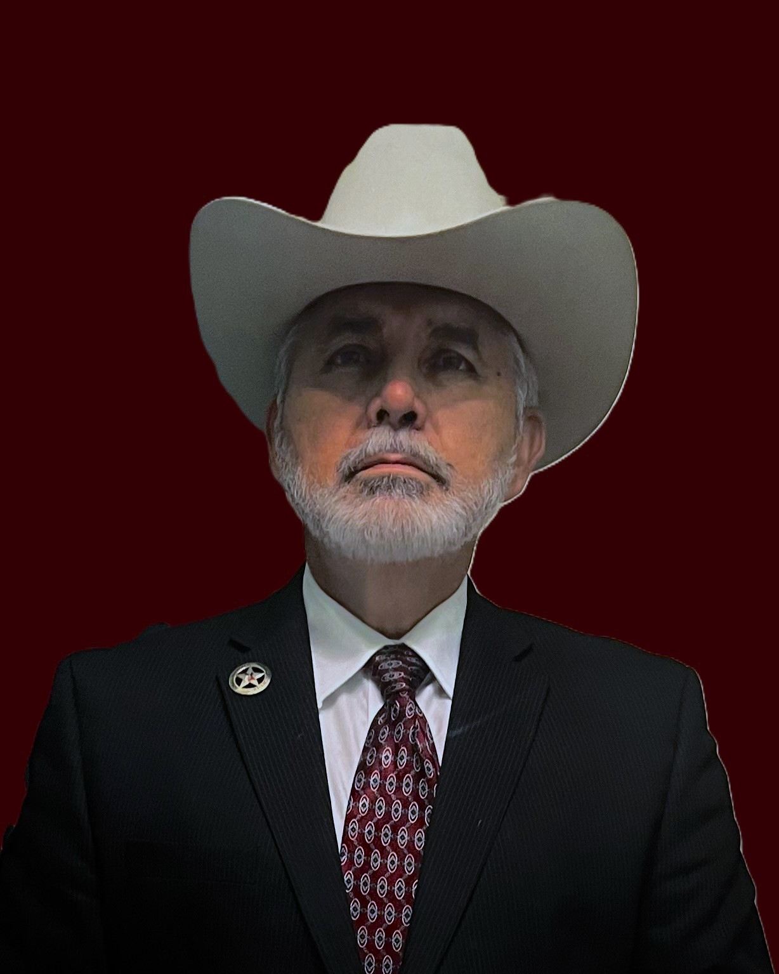
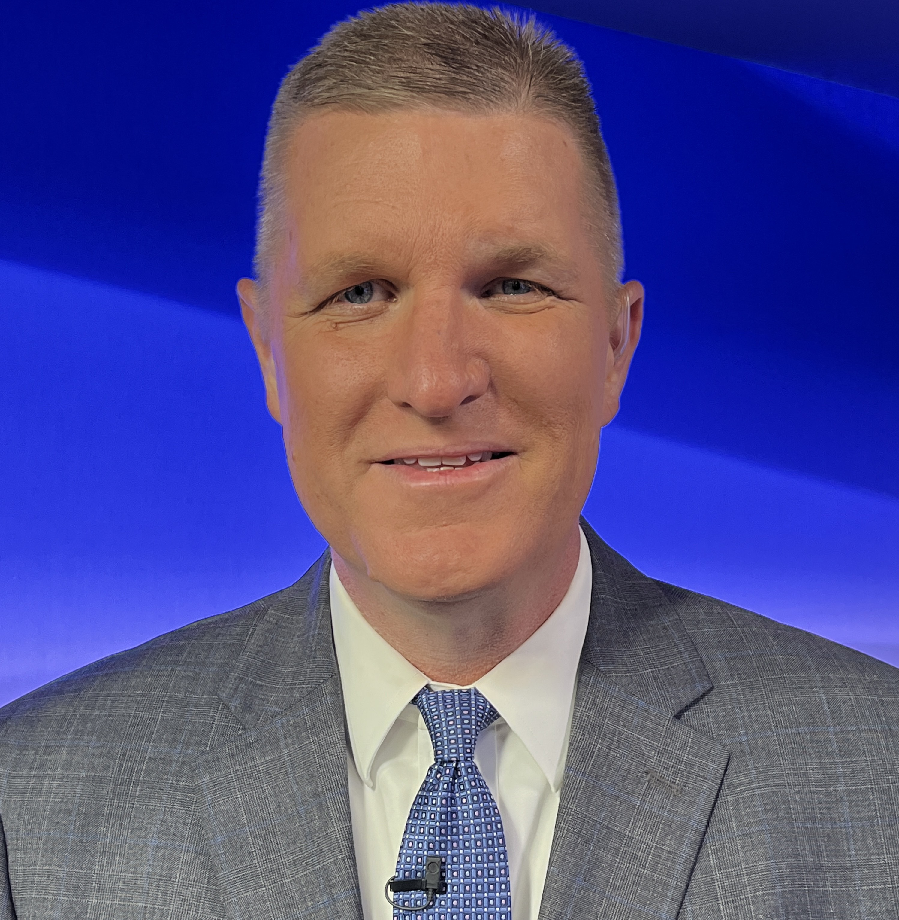
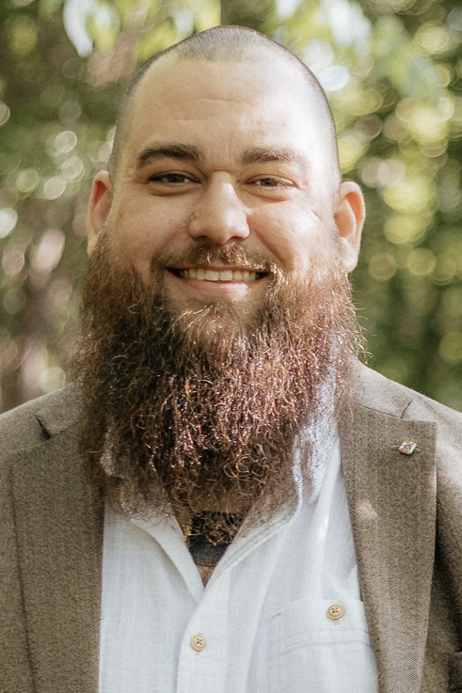
Rick Guzman
Chad Sandwell
Gregory Brown
Program Director
ETC Director
EFF Director
State Directors

Slide 103
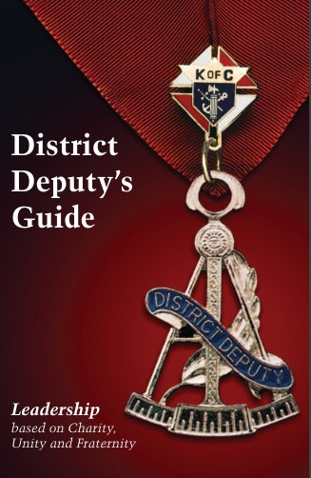
Resources
Ron Alonzo
State Deputy
Websites:
www.kofc.org
www.tkofc.org

Slide 104
Resources
This monthly publication will include information from the Major Directors about upcoming deadlines & events. Available on the 1st day of the month. This publication should be forwarded to your Councils to help them stay on track.
Texas State Council Finish Line

Slide 105
Resources
The Fraternal Leader Advisory highlights current Knights of Columbus initiatives and is released on the 1st & 3rd Thursday of each month to all Knights of Columbus Officers via email.
Sent to State Officers & Directors, DD’s & Council Officers & Directors
Anyone can sign up online.
Fraternal Leader Advisory

Slide 106
Resources
The Fraternal Leader Advisory highlights current Knights of Columbus initiatives and is released on the 1st & 3rd Thursday of each month to all Knights of Columbus Officers via email.
Sent to State Officers & Directors, DD’s & Council Officers & Directors
Anyone can sign up online.
FLA - Important Links

Slide 107
Fraternal Leader Advisory
Upcoming training schedule can be found within the FLA

Slide 108
Resources - Officers Online
Didn’t get the e-mail? Get login info from Supreme Council Customer Service Department at 1-800-380-9995
www.kofc.org

Slide 109
Resources
The Officers Desk Reference is a reference tool accessible via Officers Online. The Officers Desk Reference should be your first stop for answering any questions on Rules, Procedures, and Protocols. The Officers Desk Reference is updated often, so please use it for reference only, and not for dissemination.
Officers Desk Reference & OYP

Slide 110
Resources
FORMS ONLINE
Within Officers Online, you have access to forms that can be printed and others that can be submitted online, such as the Columbian Award Application (#SP7) and the Annual Survey of Fraternal Activity (#1728).
Forms & Reports

Slide 111
Resources
REPORTS ONLINE
Within Officers Online, you have access to the reports that detail council activity.
Forms & Reports

Slide 112
Member Resources

Slide 114
Resources
Announced in FLAs
Encourage all to watch
Wide Range of Topics
Register Online
If you miss it, It's available on demand!
Fraternal Training Webinars

Slide 115
Resources
Available on Demand
Constantly Changing Menu
Suggestions Are Welcome
Videos Are Fairly Short
Menu Is Easy To Navigate
How To Videos

Slide 116
We Need Your Help
Tell Us Your Successes
Issued 4 times a year (Deadlines are Aug 1st, November 1st, February 1st, & May 1st)
Digital Pics w/ Captions
Should Be E-Mailed
Each Council Should Have 1 Reporter
Texas Knight & State Photographer
Mark Johnson mjohnson@creatdev.com

Slide 117
FINANCIAL SECRETARY TRAINING
The Financial Secretary is vital to the success of a council. Our Financial Secretary Trainers will be providing training to new and existing financial secretaries. It is the goal of our Trainers to conduct at least 2 training sessions per diocese during the upcoming fraternal year plus several one-on-one virtual training courses on an as needed basis. The basic training takes about three hours. A stable internet is a requirement when they arrange an in-person training session. These classes are open to all council and assembly officers and District Deputies. Trainers are also available to conduct video training via Zoom.

Slide 118
FINANCIAL SECRETARY TRAINING
David Solis – Chairman El Paso & San Angelo
Peter Donahoe, Jr. Austin & San Antonio
Jerry Geigerich Gal/Hou & Victoria
Michael Murphy Brownsville, CC & Laredo
Victor Garza Dallas & Ft. Worth
Steven Webb Lubbock & Amarillo
Ed Juno Beaumont & Tyler

Slide 119
SOCIAL MEDIA
Facebook www.facebook.com/txkofc
Instagram https://instagram.com/txkofc
X
https://x.com/txkofc
You Tube
www.youtube.com
Search Texas Knights of Columbus
Anson Geisel, Chairman

Slide 120
Form 185 - Report of Officers – Now
Form 365 - Report of Program Personnel – Now
Form 1295 - Semiannual Audit (Jan – June) - August 15
Form 2629 - Report of Roundtables - September 30
Form 1728 - Fraternal Survey - January 31
Form 10784- Special Olympics - January 31
Form 1295 Semiannual Audit (July – Dec) - February 15
Form SP-7 - Columbian Application - June 30
Form 2630 - Roundtable Annual Report - June 30
IRS Form 990 or 990-n - Non-Profit Organization Tax Return – (Due based on Fraternal or Calendar Year)
Safe Environment Compliant - May 1

Slide 121
EDUCATION, TRAINING & COMMUNICATIONS
Chad Sandwell Director 409.656.4284 chadsandwell@gmail.com
Any Questions?

Slide 122
EVANGELIZATION & FAITH FORMATION

Slide 124
How are we going to bring men to Jesus Christ?
The same way Jesus brought men to himself:
Invitation (Matthew 4:19 John 1:39)
Friendship (John 15:12-15)
Brotherhood (Psalm 133:1)
Shared Mission (Acts 2:42)

Slide 125
Cor is… (Latin for Heart)
Christ centered brotherhood
Not a program – Not a meeting
Intentional and frequent time for:
Prayer
Formation
Fraternity
Open to all men of the parish
In service of the Pastor & requires his permission
Not meant to compete with other men’s ministries but to strengthen and support

Slide 126
www.kofc.org/cor
www.kofc.org/cor-es
Resources on webpage include but are not limited to:
Startup resources
Structures & Sample Timelines
Faith formation content
State & Council Leadership guides
Online Events & Training
All Cor and Faith Formation resources can be ordered on Supplies Online.

Slide 127
Council EFF Director Submission Form
http://s.alchemer.com/s3/Council-EFF-Director
Council EFF Director will receive access through Supreme to the Augustine Institute's FORMED platform, must be submitted through link

Slide 128
Measurable Success
Simply creating the space for men to encounter Christ
Keeping Christ is at the center of everything
Praying together, sharing life, building and strengthening friendships in Christ
Having fun – men enjoy coming and invite others
Pastor has endorsed and invited men to attend
Engaged leadership and consistent communication
Cor is being adopted and adapted by the culture of the parish

Slide 129
Texas State Council Evangelization and Faith Formation Team
Gregory Brown: Director
John Danley (Amarillo, El Paso, Lubbock, San Angelo)
John Plote (Beaumont, Dallas, Fort Worth, Tyler)
Jose Ramos (Brownsville, Corpus Christi, Laredo, San Antonio)
Will Britten (Austin, Houston-Galveston, Victoria)

Slide 130
Download Deck

