Slide 1
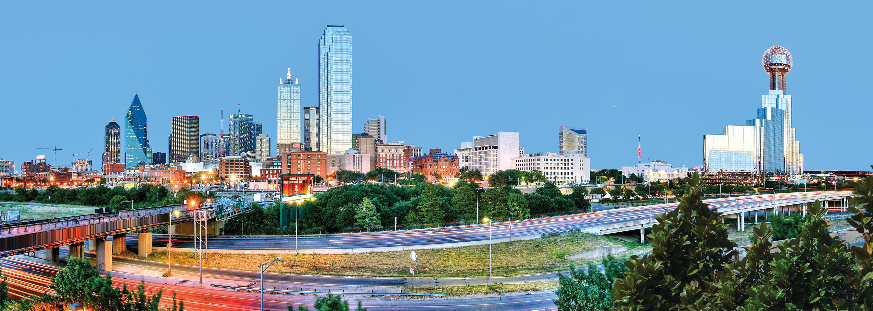
Dallas Diocesan Organizational
Kickoff Meeting
Saturday, July 20, 2024

Slide 2

Dallas Diocese Organizational Meeting - July 20, 2024
AGENDA
8:30 Call To Order – Mike Courtney
  Opening Prayer – Fr. Joseph
  Pledge of Allegiance – SK Ken Franch
  Welcome – Mike Courtney Dallas Diocesan Deputy
8:45 Chaplain Message – Fr. Joseph Mehan
9:00 State Presentation – Bill Tillotson, TSC Membership Dir.
10:30 BREAK
10:40 Knights of Columbus Financial – Don Burks
10:45 DDC Awards – Jake Fleischer,
  Bob Stras Annual Basketball Tournament
11:15 American Wheelchair Mission – Bill Weber,
Program Chairman Texas
11:25 Tom Clark – Pro-Life
11:35 KofC Insurance - John Regan
11:45 Emergency Response – Harry Storey
11:55 Fourth Degree – DM SK Ken Franch
12:05 RSVP – John Little
12:15 Committee 1000 – Mike Green
12:25 Membership – Reed Fontenot
12:30 Safe Environment – Mike Hemphill / Mike Courtney
12:45 Wrap Up – Mike Courtney
Closing Prayer – Fr. Joseph Mehan
LUNCH!!

Slide 3
Opening Prayer
Fr Joseph Mehan
DDC Chaplain
Pastor, St. Michael the Archangel - Garland

Slide 4
Pledge of Allegiance
District Master
SK Ken Franch
BJPL 3rd Texas District

Slide 5
WELCOME
Mike Courtney
Dallas Diocesan Deputy

Slide 6
Chaplain’s Message
Fr. Joseph Mehan
DDC Chaplain
Pastor, St. Michael the Archangel - Garland

Slide 7
Texas State Council
Bill Tillotson
Membership Director – Texas State Presentation

Slide 8
Dallas Diocesan Organizational Meeting
BREAK TIME!
10:00 minutes

Slide 9
KofC Insurance
Don Burks
Knights of Columbus Financial

Slide 10
DDC Awards of Excellence
Jake Fleischer
Dallas Diocese Chapter President

Slide 11
DDC Awards of Excellence
2023/24 Fraternal Year
Dallas Diocese Chapter
Awards of Excellence

Slide 12
DDC Awards of Excellence
2023/24 Fraternal Year
Dallas Diocese Chapter
Chaplain of the Year

Slide 13
DDC Awards of Excellence
2023/24 Fraternal Year
Dallas Diocese Chapter
Chaplain of the Year
Father Jet Garcia
St. Michael the Archangel, McKinney

Slide 14
DDC Awards of Excellence
2023/24 Fraternal Year
Dallas Diocese Chapter
Knight of the Year

Slide 15
DDC Awards of Excellence
2023/24 Fraternal Year
Dallas Diocese Chapter
Knight of the Year
SK Ben Oani
Prince of Peace Catholic Community, Plano

Slide 16
DDC Awards of Excellence
2023/24 Fraternal Year
Dallas Diocese Chapter
Council of the Year

Slide 17
DDC Awards of Excellence
2023/24 Fraternal Year
Dallas Diocese Chapter
Council of the Year
Fr. Emil Platte Council 5052
Farmers Branch, Texas

Slide 18
Bob Stras Memorial Basketball Tournament Kickoff
SK Roy Rabenaldt, 2024 Tournament Co-Chair

Slide 19
Record Results For 2023!
Elements | 2022 Results
Program | 48 Pages With Twice the Number of Color Pages
School Stipends | $5,000 For Each Host School for Referees, Security and Other Operating Expenses – 25% Increase!
Tee Shirts, Luggage Tags and Trophies | All Provided By The Knights
Post Game Food | 5 Out Of 6 Days (3 Per Campus) All Provided and/or Served By Brother Knights
Commemorative Coach’s Gift | Specially Inscribed Battery Power Pack
Color Corp | Color Corp Present To Present The Colors At Both The Boys And Girls Championship Games
Tournament Results | Jesuit won the Championship on the Boys Side and Bishop Lynch Finished 2nd on the Girls side.

Slide 20
Thanks To Our Sponsors & Partners ....
Councils and Assemblies – 19 Councils and Assemblies Advertised This Year. Special Thanks to Council 5052 & Assembly 2144
Individual Knight Sponsors – 55 Individual Sponsors (4 Full Page, 1 Half Page, 37 Platinum and 13 Gold Sponsorships)
Affiliated Organizations – K of C Insurance, Dallas Diocese Chapter, Third Texas District, The Dallas Degree Corps
The Stras Family – Chalice Presentation
Commercial & Foundation Sponsors
Volunteers – 21 Brother Knights from 799, 5052, 5656, 6065 and 11293
Host Schools – Bishop Lynch High School & Jesuit Dallas
Color Corp Members

Slide 21
We Want To Build on the Great Success of 2023 in the 61st Edition!
Retain the Elements Built Up Over the Years That Make the Tournament Great
Continue to Improve the Creative Impact of the Printed Program to Reinforce the Principles and Good Works of the Knights
Provide A Consistently Positive Experience for ALL Participants
Build on Our Great Relationships With Our Host Schools

Slide 22
Changes for 2024
ALL Color Program With Minimal Cost Increase
Councils and Assemblies are Encouraged to Illustrate Their Good Works of Charity and Serving the Community
Increase Individual Sponsorships – Find
“Five Good Men”

Slide 23
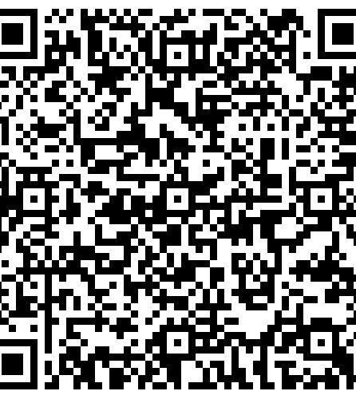
How To Place and Order
Find “Five Good Men” in Your Council or Assembly to Each Fund a $50 or $25 Sponsorship!
Fill Out The Manual Ad Commitment Form For Your Council or Go To KofCDallas.org to Place and Pay For Your Ad
FOR MORE INFO GO TO : KofCDallas.org/store/

Slide 24
For More Information....
Contact Tournament Co-Chairs
SK Roy Rabenaldt – 214-533-6558
royrab@sbcglobal.net
Jake Fleischer – 214-232-1084
johnfleischer7@gmail.com

Slide 25

Dallas Diocese Chapter
Additional Reminders:
Silver Rose
Pilgrim Icon
Clergy Appreciation Dinner
October DDC Meeting
“Committee of 1000” – Michael Greene
Chuck Johnson – Director of Operations and Communications

Slide 26
Silver Rose & I con
Tony Stobb
KofCDallas.org/programs/silver-rose/
KofCDallas.org/programs/pilgrim-icon/

Slide 27

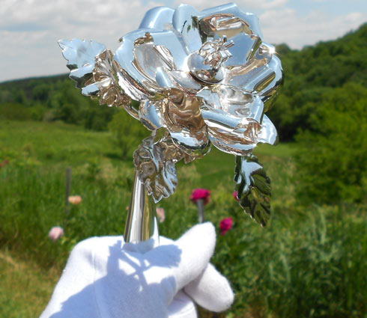
Pilgrimage of the Silver Rose
Faith In Action – Pro Life Program
Demonstrates Unity between Knights of Columbus in Canada, USA, and Mexico
Rose Travels through Canda, USA, Mexico to Our Lady of Guadeloupe Shrine
Prayer services promoting the dignity of all human life, and honoring Our Lady
  Rosary for the Protection of the Sanctity of Life
  Liturgy of the Word
  Act of Consecration to, and Litany of the Blessed Virgin Mary
Additional Resource Links:
  Silver Rose Pilgrimage
  Faith In Action Programs
Schedule: Spring 2025
kofcdallas.org/programs/silver-rose/
Dallas Diocese Contact: Tony Stobb, DD 115
stobbdad@yahoo.com
972-672-6830
Materials provided in English & Spanish

Slide 28
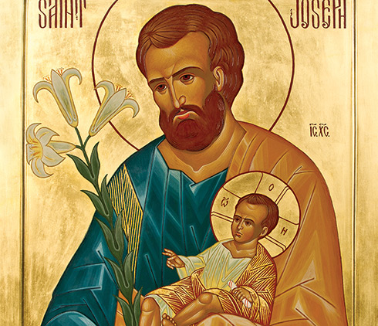
Pilgrim Icon Program
Faith In Action - Faith Program
Knights of Columbus selects a Saint whose patronage is inspiring to Knights and their communities
Icon used as focal point for prayer service
Prayer Service consists of:
  Liturgy of the Word
  Catechesis Regarding Devotion to the Saint
  Prayer Intercessions
  Rosary
Additional Resource Links:
  Pilgrim Icon Program
  Faith In Action Programs
Schedule: To Be Announced
kofcdallas.org/programs/pilgrim-icon/
Dallas Diocese Contact: Tony Stobb, DD 115
stobbdad@yahoo.com
972-672-6830
Materials provided in English & Spanish

Slide 29
American Wheelchair Mission
Bill Weber
Program Chairman Texas

Slide 30
Pro-Life
Tom Clark
Pro Life Chairman

Slide 31
KofC Insurance
John Regan
General Agent North Texas

Slide 32
Emergency Response
Harry Storey
State Emergency Response Chairman

Slide 33
Fourth Degree
District Master
SK Ken Franch
BJPL 3rd Texas District

Slide 34
Bishop Joseph Patrick Lynch (BJPL)
Third Texas District
From July 1, 2023, through July 1, 2024 - the Third TX District has the most members (4,702) and the most assemblies (40) in the Our Lady of Guadalupe Province (OLoGP)
Added 231 new SKs in 2023 - 2024 (86%)…if only 37 more for 100%
Added 2 new Assemblies in 2023 - 2024:
  Fray Juan de Zumarraga Assembly 3970, Dallas, TX - first Spanish Assembly in the District
  Rev. Loyd Morris Assembly 4001, Prosper, TX - officers were installed on 7/4/24
Assemblies:
  Dallas – 15, Fort Worth – 14, Tyler - 11

Slide 35
Bishop Joseph Patrick Lynch (BJPL)
Third Texas District
Fall Exemplification planning underway:
  FW Diocese - September 21 in Grapevine, TX (StFoA)
  Dallas Diocese - October 12 in Dallas area…looking!!
Met with Fr. Vincent Anyama at Seminary…wanting 3 flag poles installed; donations from District Assemblies will pay for materials/installation
Catholic Bowl IV - September 14, 2024, at the Star in Frisco. CC request for first game. Proceeds will go to Cristo Rey Dallas and Ft. Worth. More info to follow.
District website: kofcntxpatriotic.org - has been updated with FN and CCC contact information. Remember website has bulletins from VA with info for our veterans.

Slide 36
Bishop Joseph Patrick Lynch (BJPL)
Third Texas District
Changes from our Supreme Master (SM):
  Monthly newsletter - DM forwards to FNs; will try to add to website
  Name badges can be worn on right side of jacket…no in left pocket badges, pocket is sewn shut…
  New ceremony not until 125th anniversary of the 4th Degree on February 22, 2025
A new BJPL Third Texas District has been chosen…SK Kevin McGillis, PFN of Assembly 3553 in Allen, TX…effective September 1, 2024
My last 6 weeks as BJPL DM...
  Thank you all for your support over these past 4 years
  Especially thank you for your prayers this year!!

Slide 37
Bishop Joseph Patrick Lynch (BJPL)
Third Texas District
The Fourth Degree…
Religiously Devoted,
Patriotically Proud!

Slide 38
R S V P
John Little
Refund Support Vocations Program Chairman

Slide 39
R S V P
REFUND SUPPORTED VOCATIONS PROGRAM
Councils, Assemblies and Squire Circles “adopt” or “sponsor” one or more seminarians and provide financial assistance and moral support.

Slide 40
R S V P
This program is critical to the development of future priests.
Many seminarians do not come from wealthy families; quite the opposite. They don’t have family money to support them, and financial burdens can often drive them away from their vocation.
These donations make it possible for these men to focus upon their formation as future priests.

Slide 41
R S V P
How it works
Councils and Assemblies write checks, payable to their adopted seminarians ($500 per sponsorship). Squire Circles can write checks in $100 increments.
All must complete and file Form 2863 with Supreme.
Councils and Assemblies receive a $100 refund for each $500 donated.
Circles receive a $20 refund for each $100 donated.

Slide 42
Committee of 1000
Michael Greene
Program Chairman

Slide 43
Committee of 1000
This is a project of the DDC. Membership contributions are presented on behalf of the Committee members to the Office of Vocations of the Dallas Diocese.
These contributions are used as a discretionary fund by the Director of Seminarians to provide financial assistance to seminarians.
A symbolic ”Praying Hands" PIN identifies members of the Committee of 1000. The color of the pin is changed each year to reflect the new drive.

Slide 44
Committee of 1000
Seminarians come from all walks of life and their needs vary from simple things like money for books, tuition, emergency trips home, or required physicals.
In the past funds have also been used to purchase a suit for a seminarian who was to begin his parish work.
The Committee accepts $10.00 contributions (per pin) annually from individual Knights as well as their spouses, associates, and friends in the Dallas Diocese. The only common denominator is their desire to support our seminarians.

Slide 45
Membership
Reed Fontenot
Texas State WARDEN

Slide 46
Safe Environment Program
Mike Courtney
Dallas Diocesan Deputy
Mike Hemphill
Dallas Diocesan Safety Director

Slide 47
Wrap Up
Mike Courtney
Dallas Diocesan Deputy

Slide 48
Closing Prayer
Fr Joseph Mehan
DDC Chaplain
Pastor, St. Michael the Archangel - Garland

Slide 49
FRATERNITY
LUNCH TIME!

Slide 50


